Slide 1
Classification: probabilistic classifiers 生醫光電所 吳育德
Chap5. A First Course in Machine Learning, 2ed, Simon Rogers and Mark Girolami, 2017

Slide 2
Outlines
You have learned, for a model and based on observed data, we can
Find parameters that minimize a loss function,
Find parameters that maximize a likelihood function
Treat parameters as random variables and using Bayes’ rule
and make predictions.
You will learn probabilistic classifiers
Bayes classifier and Naïve Bayes classifier
Logistic regression
And non-probabilistic Classifiers
3. K-nearest neighbors
4. Support vector machines and other kernel methods

Slide 3
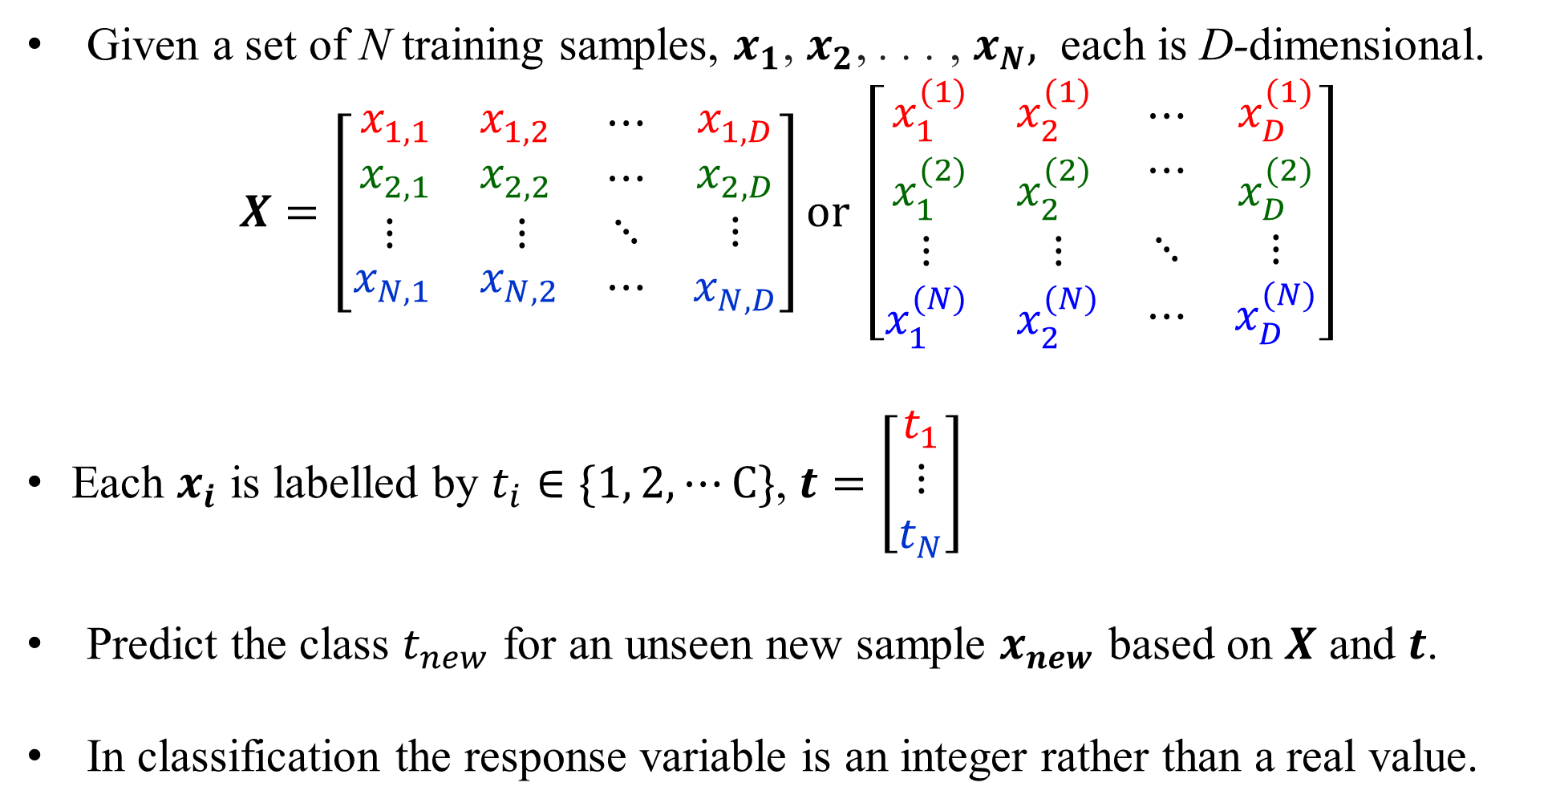
The General Classification Problem
Given a set of N training samples, $x_{1}$, $x_{2}$, . . . , $x_{N},$ each is D-dimensional.
$$X=\left[\begin{matrix}\begin{matrix}x_{1,1} & x_{1,2} \\ x_{2,1} & x_{2,2}\end{matrix} & \begin{matrix}⋯ \\ ⋯\end{matrix} & \begin{matrix}x_{1,D} \\ x_{2,D}\end{matrix} \\ \begin{matrix}⋮ & ⋮\end{matrix} & ⋱ & ⋮ \\ \begin{matrix}x_{N,1} & x_{N,2}\end{matrix} & ⋯ & x_{N,D}\end{matrix}\right]or \left[\begin{matrix}\begin{matrix}x_{1}^{(1)} & x_{2}^{(1)} \\ x_{1}^{(2)} & x_{2}^{(2)}\end{matrix} & \begin{matrix}⋯ \\ ⋯\end{matrix} & \begin{matrix}x_{D}^{(1)} \\ x_{D}^{(2)}\end{matrix} \\ \begin{matrix}⋮ & ⋮\end{matrix} & ⋱ & ⋮ \\ \begin{matrix}x_{1}^{(N)} & x_{2}^{(N)}\end{matrix} & ⋯ & x_{D}^{(N)}\end{matrix}\right]$$
Each $x_{i}$ is labelled by $t_{i}∈\{1, 2, ⋯C\}$, $t=\left[\begin{matrix}t_{1} \\ ⋮ \\ t_{N}\end{matrix}\right]$
Predict the class $t_{new}$ for an unseen new sample $x_{new}$ based on $X$ and $t$.
In classification the response variable is an integer rather than a real value.

Slide 4
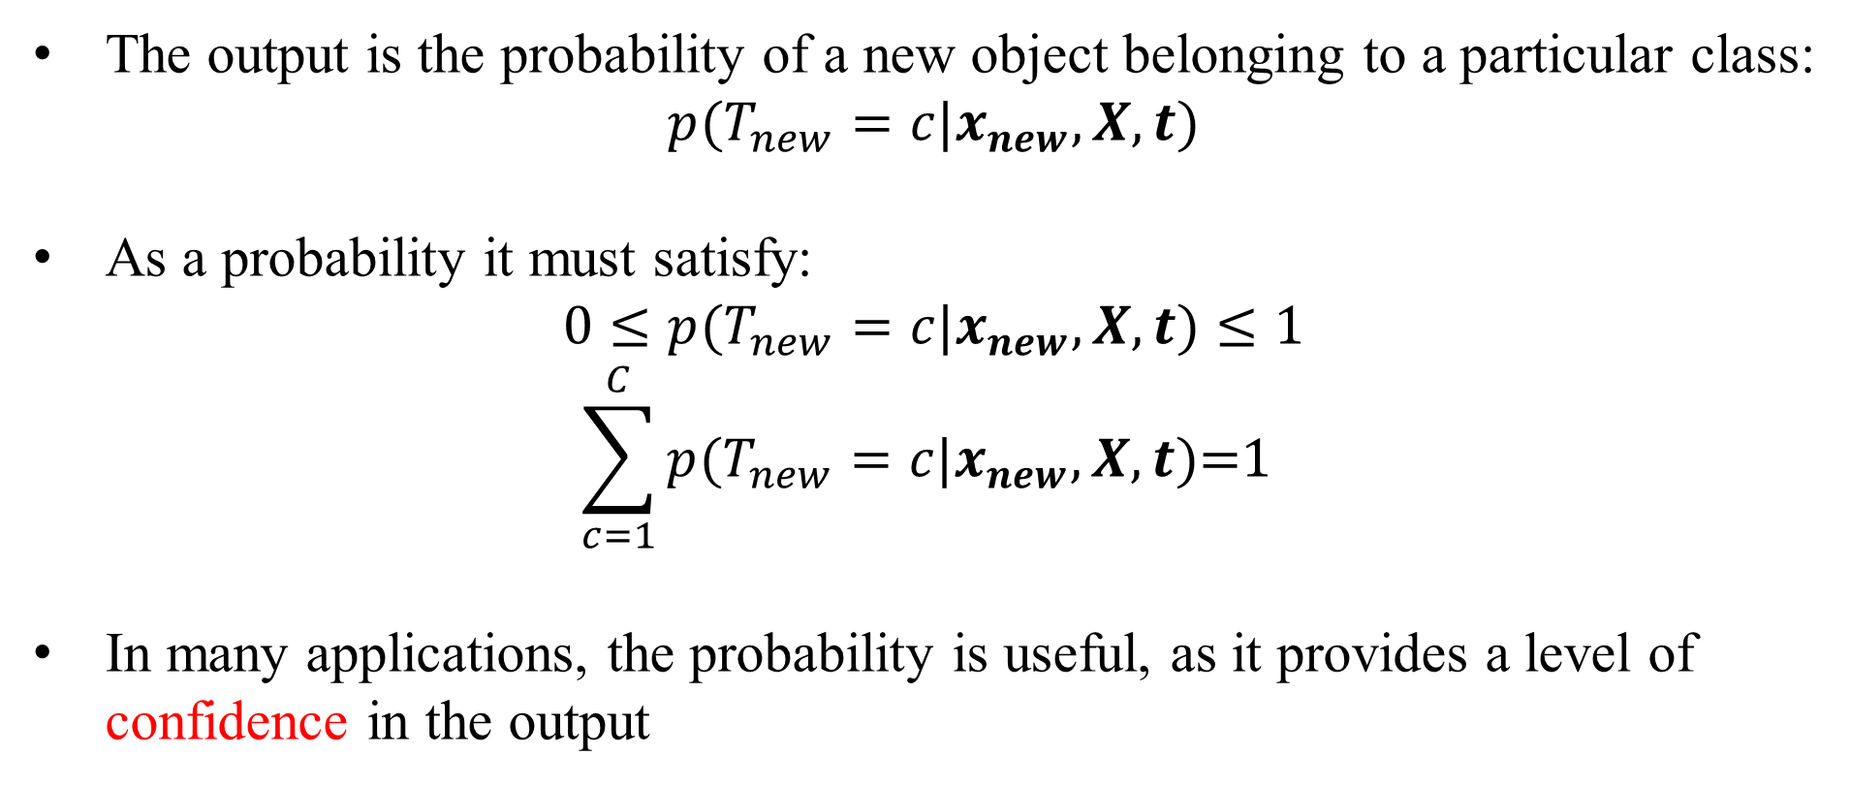
Probabilistic Classifiers
The output is the probability of a new object belonging to a particular class:
$$p(T_{new}=c{|x}_{new},X,t)$$
As a probability it must satisfy:
$$0≤p(T_{new}=c{|x}_{new},X,t)≤1$$
$$\sum_{c=1}^{C}{p(T_{new}=c{|x}_{new},X,t)\text{=1} }$$
In many applications, the probability is useful, as it provides a level of confidence in the output

Slide 5
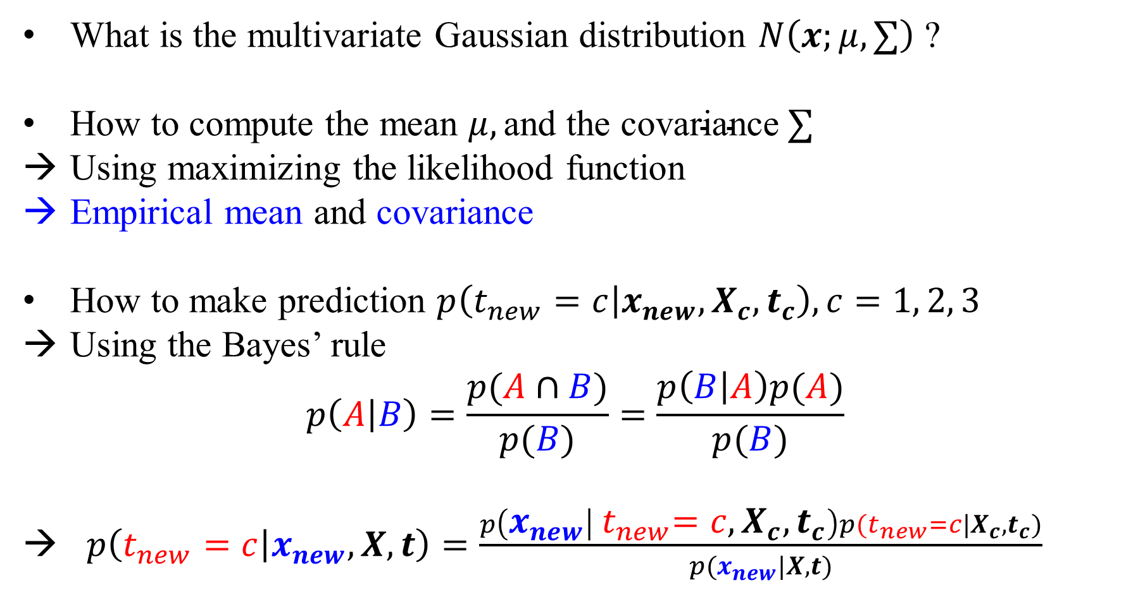
We need to know
What is the multivariate Gaussian distribution $N\left(x;μ,∑\right)$ ?
How to compute the mean $μ,\text{and} \text{the} \text{covariance} ∑$
Using maximizing the likelihood function
Empirical mean and covariance
How to make prediction $p\left(t_{new}=c | x_{new}, X_{c}, t_{c}\right), c=1, 2, 3$
Using the Bayes’ rule
$$p\left(A | B\right)=\frac{p(A∩B)}{p(B)}=\frac{p\left(B | A\right)p(A)}{p(B)}$$
→ $p\left(t_{new}=c | x_{new},X,t\right)=\frac{p\left(x_{new} | { t}_{new}=c,X_{c}, t_{c}\right)p{(t}_{new}=c|X_{c}, t_{c})}{p(x_{new}|X,t)}$

Slide 6
Gaussian Distribution

Slide 7
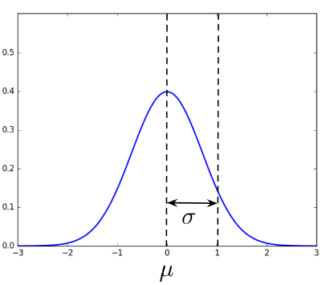
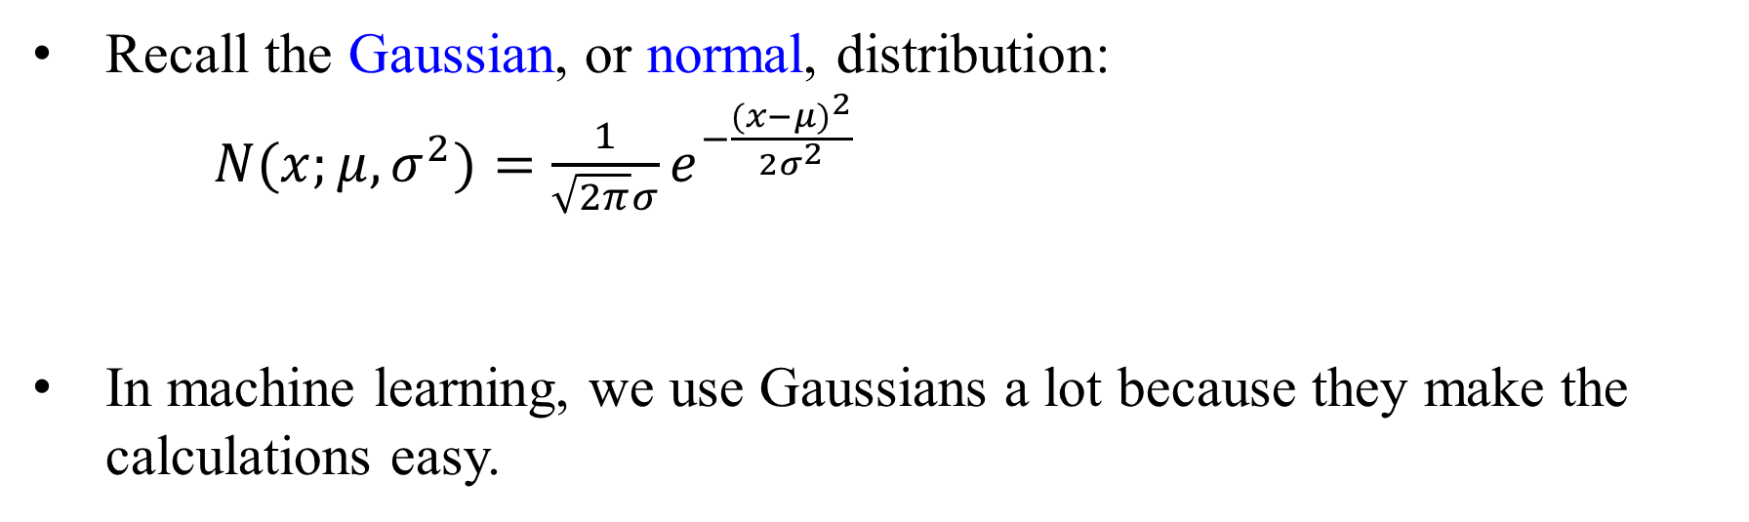
Gaussian Distribution
Recall the Gaussian, or normal, distribution:
$N(x;μ,σ^{2})=\frac{1}{\sqrt{2π}σ}e^{−\frac{{(x−μ)}^{2}}{2σ^{2}}}$
In machine learning, we use Gaussians a lot because they make the calculations easy.

Slide 8
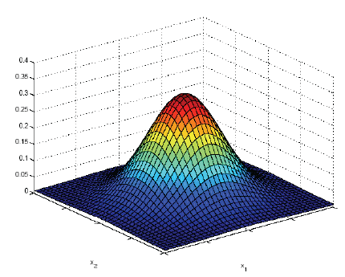
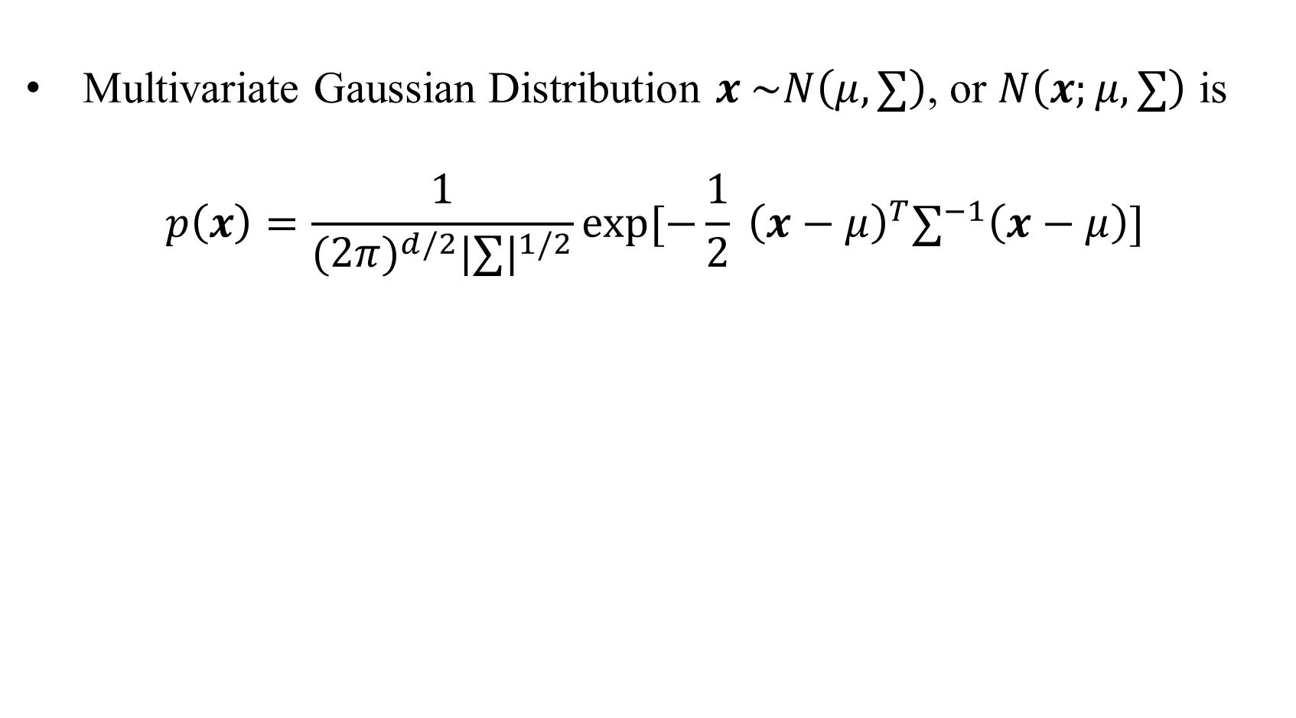
Multivariate Gaussian Distribution
Multivariate Gaussian Distribution $x \sim N\left(μ,∑\right)$, or $N\left(x;μ,∑\right)$ is
$$p\left(x\right)=\frac{1}{{(2π)}^{d/2}{|∑|}^{1/2}}exp[−\frac{1}{2} {\left(x−μ\right)}^{T}∑^{−1}\left(x−μ\right)]$$

Slide 9
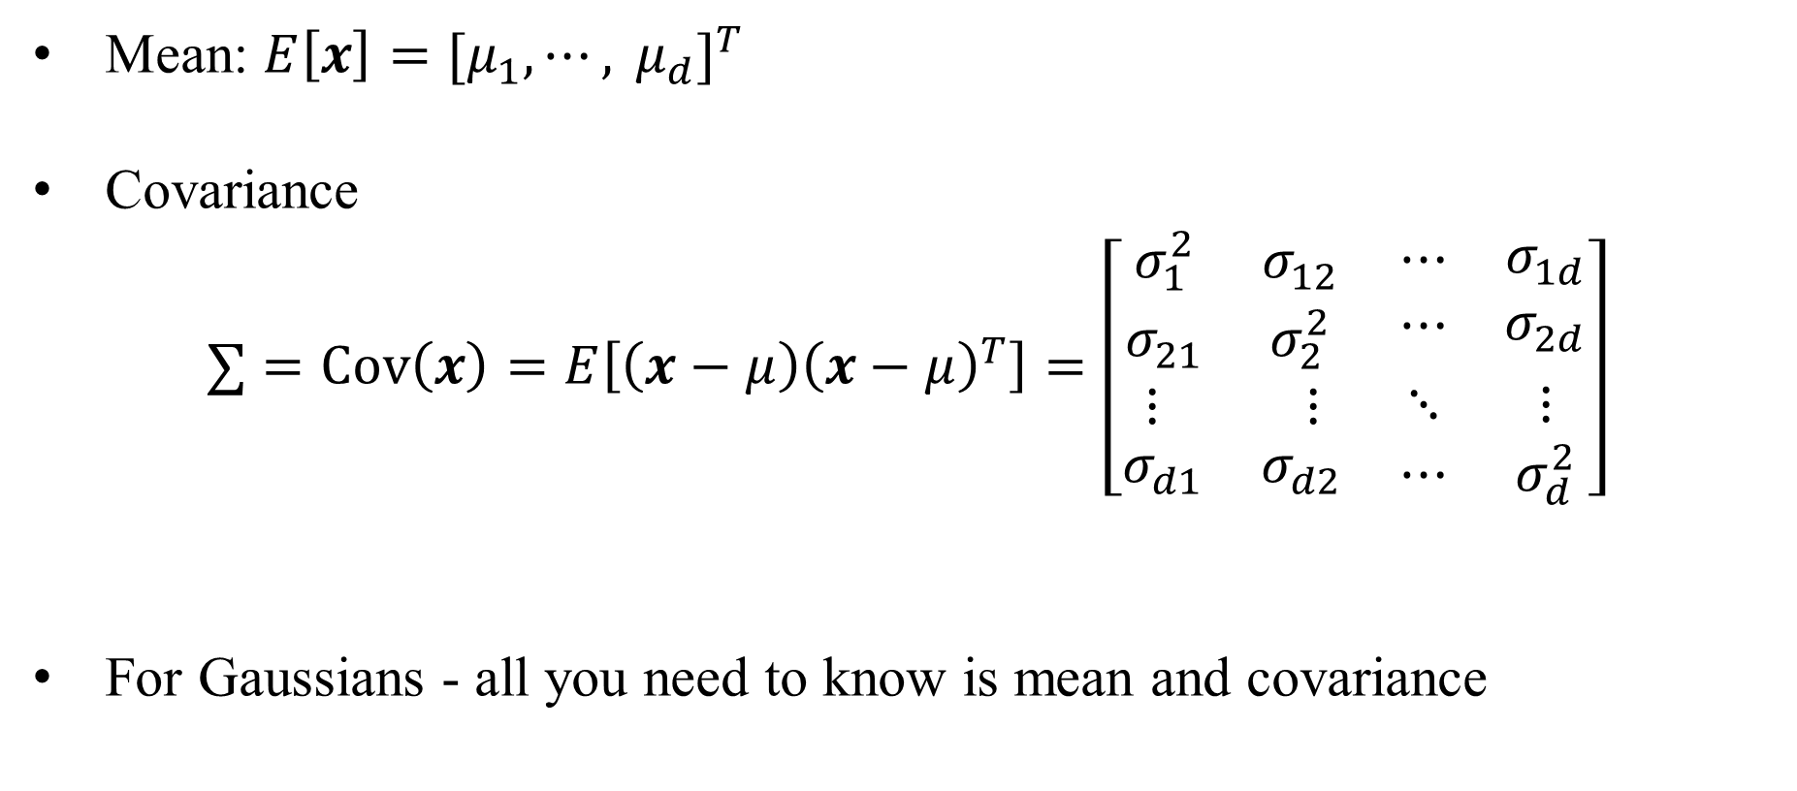
Multivariate parameters
Mean: $E\left[x\right]={[μ_{1}, ⋯, μ_{d}]}^{T}$
Covariance
$$∑=Cov\left(x\right)=E\left[{\left(x−μ\right)\left(x−μ\right)}^{T}\right]=\left[\begin{matrix}\begin{matrix}σ_{1}^{2} & σ_{12} \\ σ_{21} & σ_{2}^{2}\end{matrix} & \begin{matrix}⋯ \\ ⋯\end{matrix} & \begin{matrix}σ_{1d} \\ σ_{2d}\end{matrix} \\ \begin{matrix}⋮ & ⋮\end{matrix} & ⋱ & ⋮ \\ \begin{matrix}σ_{d1} & σ_{d2}\end{matrix} & ⋯ & σ_{d}^{2}\end{matrix}\right]$$
For Gaussians - all you need to know is mean and covariance

Slide 10
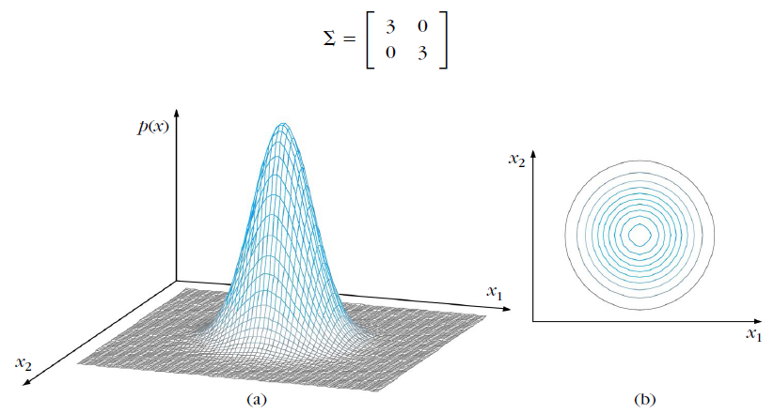
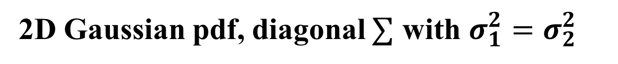
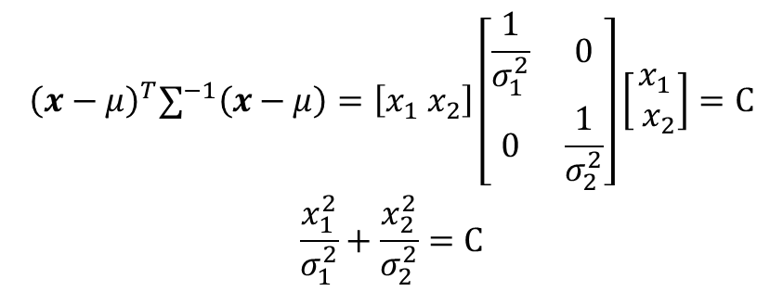
2D Gaussian pdf, diagonal $∑$ with $σ_{1}^{2}=σ_{2}^{2}$
$${\left(x−μ\right)}^{T}∑^{−1}\left(x−μ\right)=\left[x_{1}{ x}_{2}\right]\left[\begin{matrix}\frac{1}{σ_{1}^{2}} & 0 \\ 0 & \frac{1}{σ_{2}^{2}}\end{matrix}\right]\left[\begin{matrix}x_{1} \\ { x}_{2}\end{matrix}\right]=C$$
$$\frac{x_{1}^{2}}{σ_{1}^{2}}+\frac{x_{2}^{2}}{σ_{2}^{2}}=C$$

Slide 11
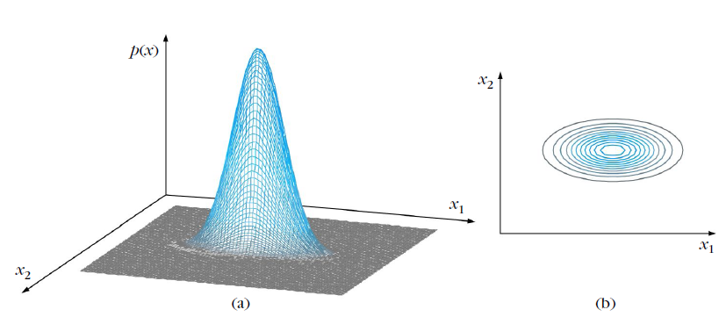
2D Gaussian pdf, diagonal $∑$ with $σ_{1}^{2}=15≫σ_{2}^{2}=3$

Slide 12
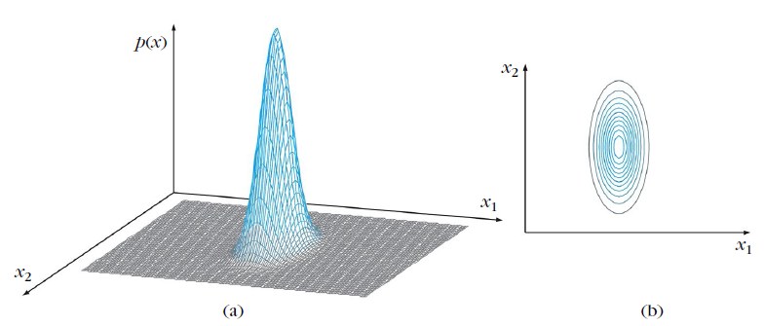
2D Gaussian pdf, diagonal $∑$ with $σ_{1}^{2}=3≪σ_{2}^{2}=15$

Slide 13
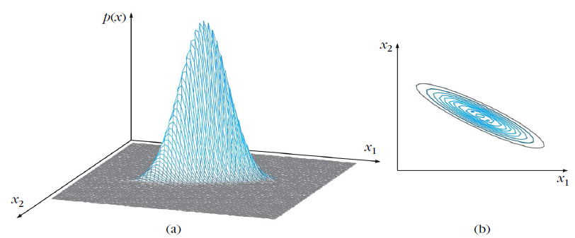

2D Gaussian pdf, non-diagonal $∑$

Slide 14
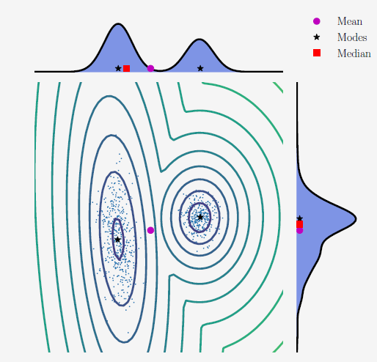
Mean, mode, median for a 2D Dataset and its marginal densities
M. P. Deisenroth, A. A. Faisal, C. S. Ong, Mathematics For Machine Learning, Cambridge University Press, 2019

Slide 15
Maximum Likelihood

Slide 16
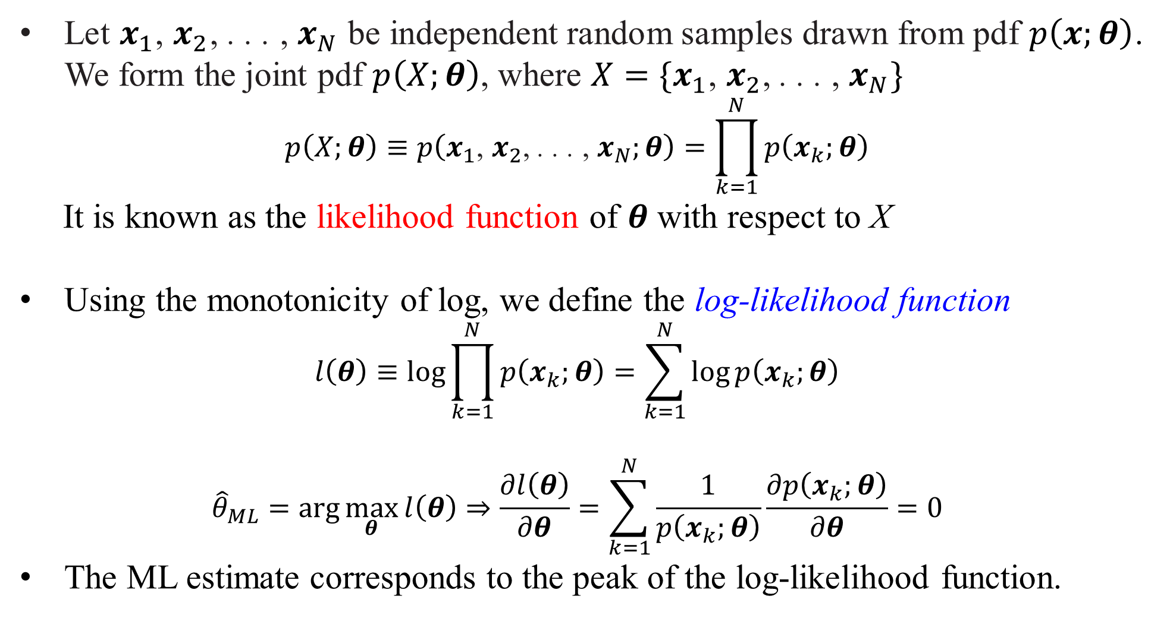
Maximum Likelihood
Let $x_{1}$, $x_{2}$, . . . , $x_{N}$ be independent random samples drawn from pdf $p\left(x;θ\right)$. We form the joint pdf $p\left(X;θ\right)$, where $X=\{x_{1}$, $x_{2}$, . . . , $x_{N}\}$
$$p\left(X;θ\right)≡p\left(x_{1}\text{, }x_{2}\text{, }\text{. . . }\text{, }x_{N};θ\right)=\prod_{k=1}^{N}{p\left(x_{k};θ\right)}$$
It is known as the likelihood function of $θ$ with respect to X
Using the monotonicity of log, we define the log-likelihood function
$$l\left(θ\right)≡\log{\prod_{k=1}^{N}{p\left(x_{k};θ\right)}}=\sum_{k=1}^{N}{\log{p\left(x_{k};θ\right)}}$$
$${\hat{θ}}_{ML}=\arg{\max_{θ}{l\left(θ\right)}}⇒\frac{∂l\left(θ\right)}{∂θ}=\sum_{k=1}^{N}{\frac{1}{p\left(x_{k};θ\right)}}\frac{∂p\left(x_{k};θ\right)}{∂θ}=0$$
The ML estimate corresponds to the peak of the log-likelihood function.

Slide 17
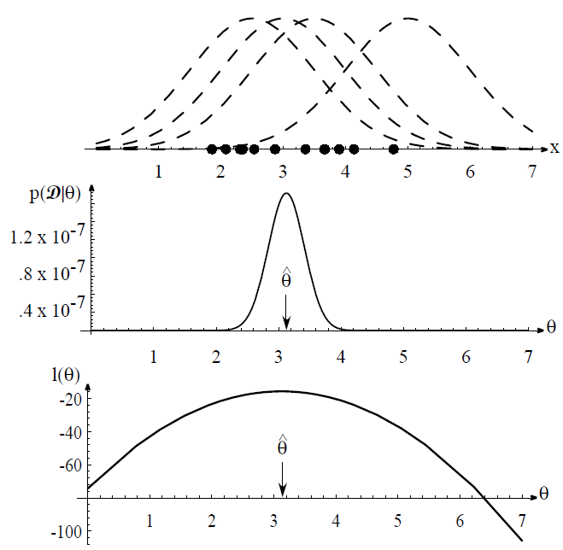
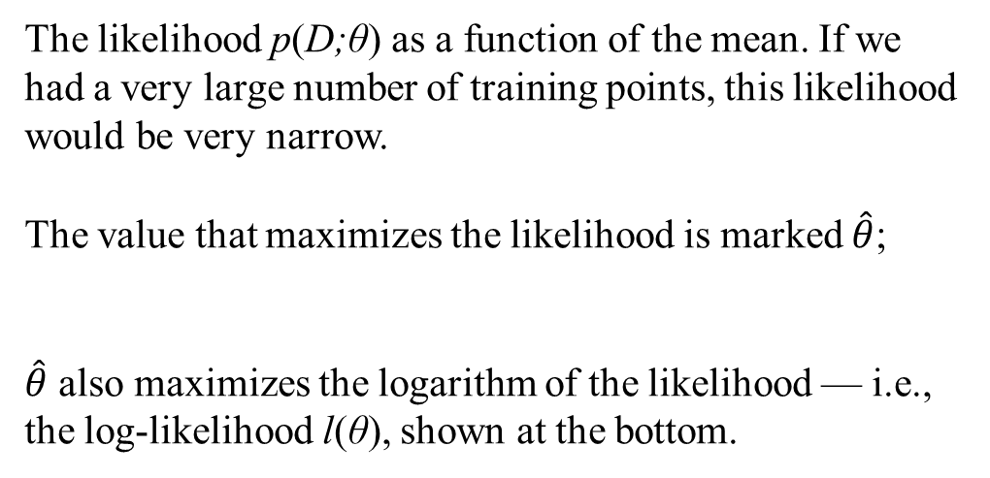
Maximum Likelihood
Assume 1D training points are drawn from a Gaussian of a particular variance, but unknown mean. Four of the infinite number of candidate source distributions are shown in dashed lines.
The likelihood p(D;θ) as a function of the mean. If we had a very large number of training points, this likelihood would be very narrow.
The value that maximizes the likelihood is marked $\hat{θ}$;
$\hat{θ}$ also maximizes the logarithm of the likelihood — i.e., the log-likelihood l(θ), shown at the bottom.

Slide 18
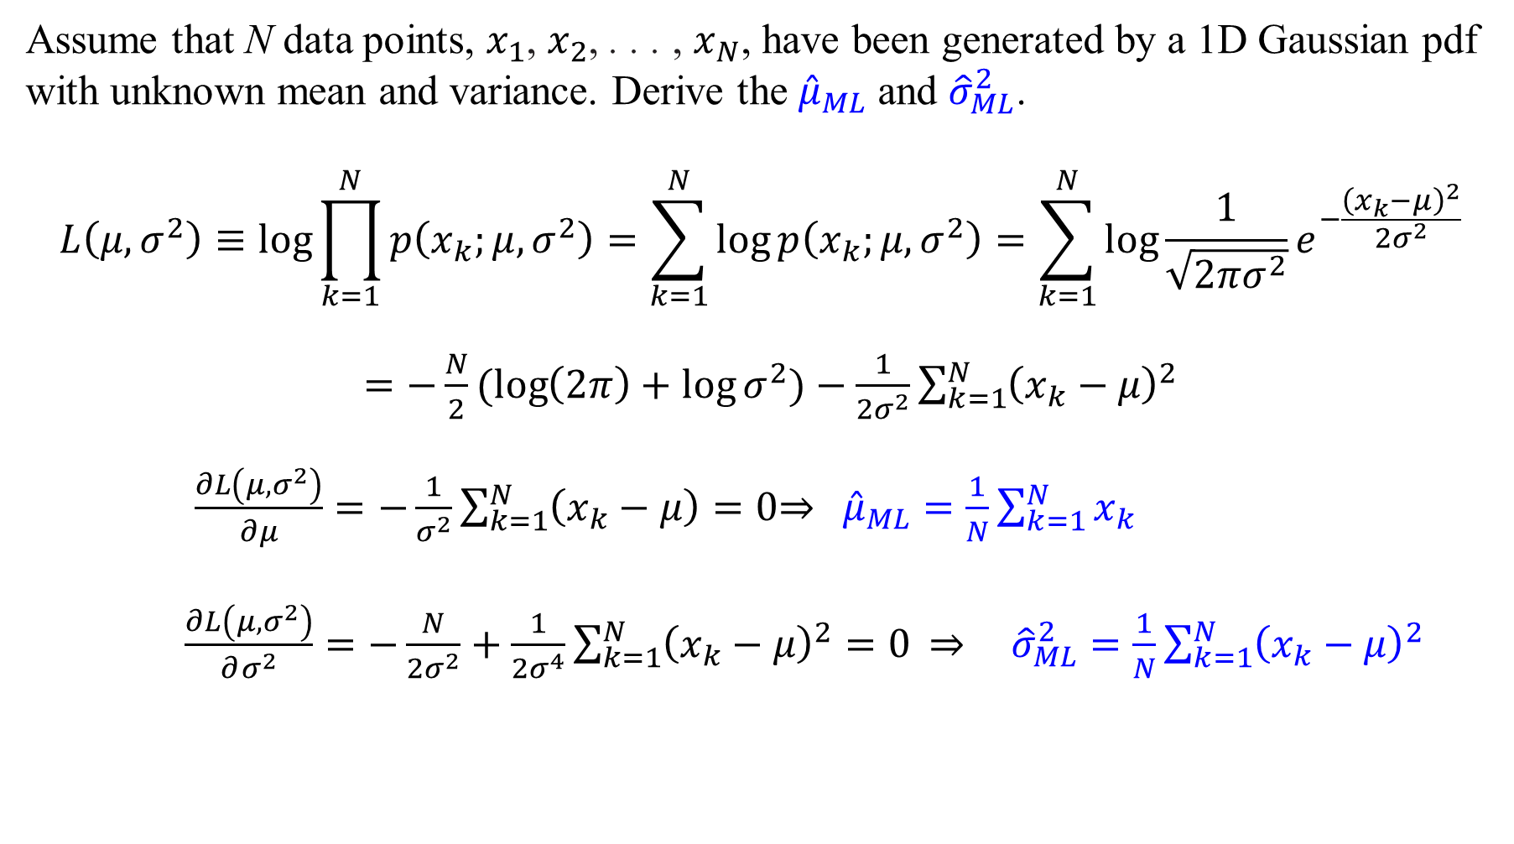
Maximum Likelihood
Assume that N data points, $x_{1}$, $x_{2}$, . . . , $x_{N}$, have been generated by a 1D Gaussian pdf with unknown mean and variance. Derive the ${\hat{μ}}_{ML}$ and ${\hat{σ}}_{ML}^{2}$.
$$L\left(μ, σ^{2}\right)≡\log{\prod_{k=1}^{N}{p\left(x_{k};{μ,σ}^{2}\right)}}=\sum_{k=1}^{N}{\log{p\left(x_{k};{μ,σ}^{2}\right)}}=\sum_{k=1}^{N}{\log{\frac{1}{\sqrt{2πσ^{2}}}e^{−\frac{{\left(x_{k}−μ\right)}^{2}}{2σ^{2}}}}}$$
$=−\frac{N}{2}(log\left(2π\right)+\log{σ^{2}})−\frac{1}{2σ^{2}}\sum_{k=1}^{N}{{\left(x_{k}−μ\right)}^{2}}$
$\frac{∂L\left(μ,σ^{2}\right)}{∂μ}=−\frac{1}{σ^{2}}\sum_{k=1}^{N}{\left(x_{k}−μ\right)}=0$⇒ ${\hat{μ}}_{ML}=\frac{1}{N}\sum_{k=1}^{N}{x_{k}}$
$\frac{∂L\left(μ,σ^{2}\right)}{∂σ^{2}}=−\frac{N}{2σ^{2}}+\frac{1}{2σ^{4}}\sum_{k=1}^{N}{{\left(x_{k}−μ\right)}^{2}}=0$ ⇒ ${\hat{σ}}_{ML}^{2}=\frac{1}{N}\sum_{k=1}^{N}{{\left(x_{k}−μ\right)}^{2}}$

Slide 19
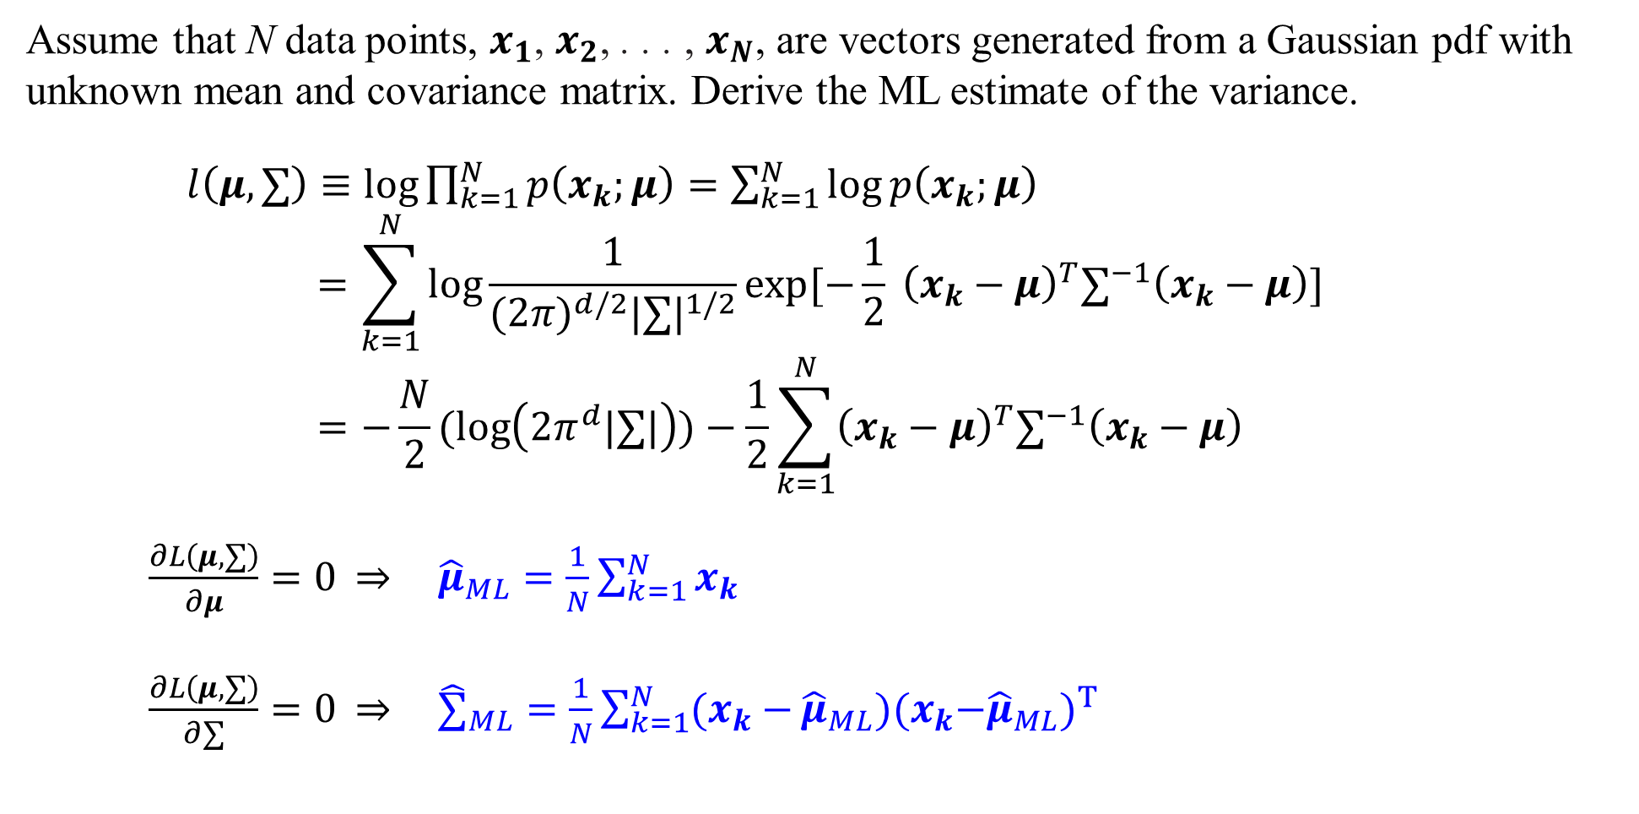
Maximum Likelihood
Assume that N data points, $x_{1}$, $x_{2}$, . . . , $x_{N}$, are vectors generated from a Gaussian pdf with unknown mean and covariance matrix. Derive the ML estimate of the variance.
$l\left(μ,∑\right)≡\log{\prod_{k=1}^{N}{p\left(x_{k};μ\right)}}=\sum_{k=1}^{N}{\log{p\left(x_{k};μ\right)}}$
$$=\sum_{k=1}^{N}{\log{\frac{1}{{(2π)}^{d/2}{|∑|}^{1/2}}exp[−\frac{1}{2} {\left(x_{k}−μ\right)}^{T}∑^{−1}\left(x_{k}−μ\right)] }}=−\frac{N}{2}(log\left({2π}^{d}|∑|\right))−\frac{1}{2}\sum_{k=1}^{N}{{\left(x_{k}−μ\right)}^{T}∑^{−1}\left(x_{k}−μ\right)}$$
$\frac{∂L\left(μ,∑\right)}{∂μ}=0$ ⇒ ${\hat{μ}}_{ML}=\frac{1}{N}\sum_{k=1}^{N}{x_{k}}$
$\frac{∂L\left(μ,∑\right)}{∂∑}=0$ ⇒ ${\hat{∑}}_{ML}=\frac{1}{N}\sum_{k=1}^{N}{(x_{k}−}{\hat{μ}}_{ML}){{(x}_{k}−{\hat{μ}}_{ML})}^{T}$

Slide 20
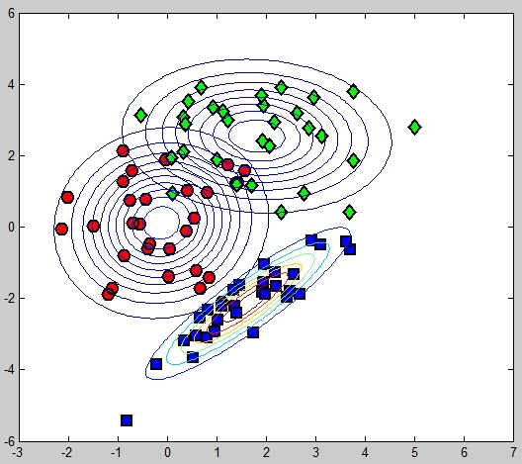
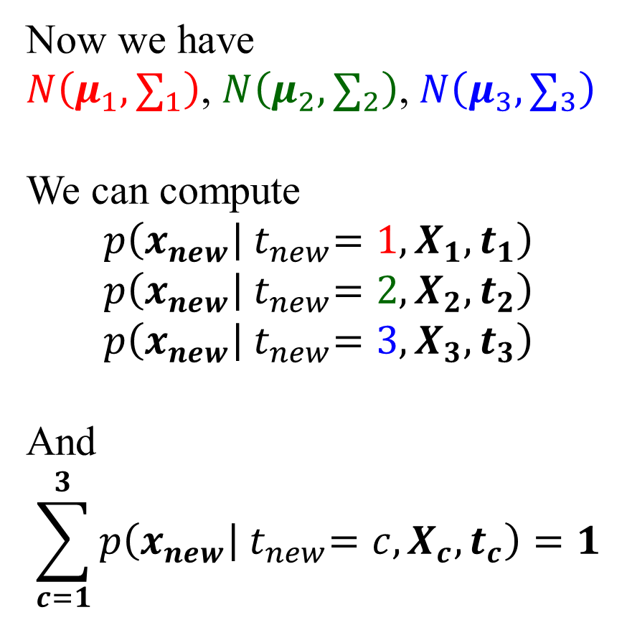
Maximum Likelihood: An example with three classes (plotcc.m)
Now we have
$N\left(μ_{1}, ∑_{1}\right)$, $N\left(μ_{2}, ∑_{2}\right)$, $N\left(μ_{3}, ∑_{3}\right)$
We can compute
$$p\left(x_{new} | { t}_{new}=1, X_{1},t_{1}\right)$$
$$p\left(x_{new} | { t}_{new}=2,X_{2},t_{2}\right)$$
$$p\left(x_{new} | { t}_{new}=3,X_{3},t_{3}\right)$$
And
$$\sum_{c=1}^{3}{p\left(x_{new} | { t}_{new}=c,X_{c},t_{c}\right)}=1$$
plotcc.m

Slide 21
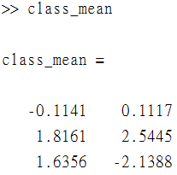
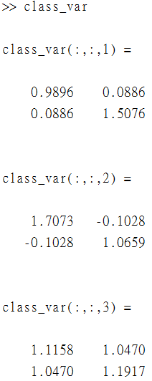
Fit class-conditional Gaussians for each class (plotcc.m)
class_var = [];
for c = 1:length(cl)
pos = find(t==cl(c));
% Find the means
class_mean(c,:) = mean(X(pos,:));
class_var(:,:,c) = cov(X(pos,:),1);
end
%% Plot the contours
for c = 1:length(cl)
pos = find(t==cl(c));
plot(X(pos,1),X(pos,2),col{c},...
'markersize',10,'linewidth',2,'markerfacecolor',fcol{c});
end
xlim([-3 7]),ylim([-6 6])
[Xv,Yv] = meshgrid(-3:0.1:7,-6:0.1:6);
for c = 1:length(cl)
temp = [Xv(:)-class_mean(c,1) Yv(:)-class_mean(c,2)];
tempc = class_var(:,:,c);
const = -log(2*pi) - log(det(tempc));
Probs = exp(const - 0.5*diag(temp*inv(tempc)*temp'));
contour(Xv,Yv,reshape(Probs,size(Xv)));
end

Slide 22
Bayes’ Rule

Slide 23
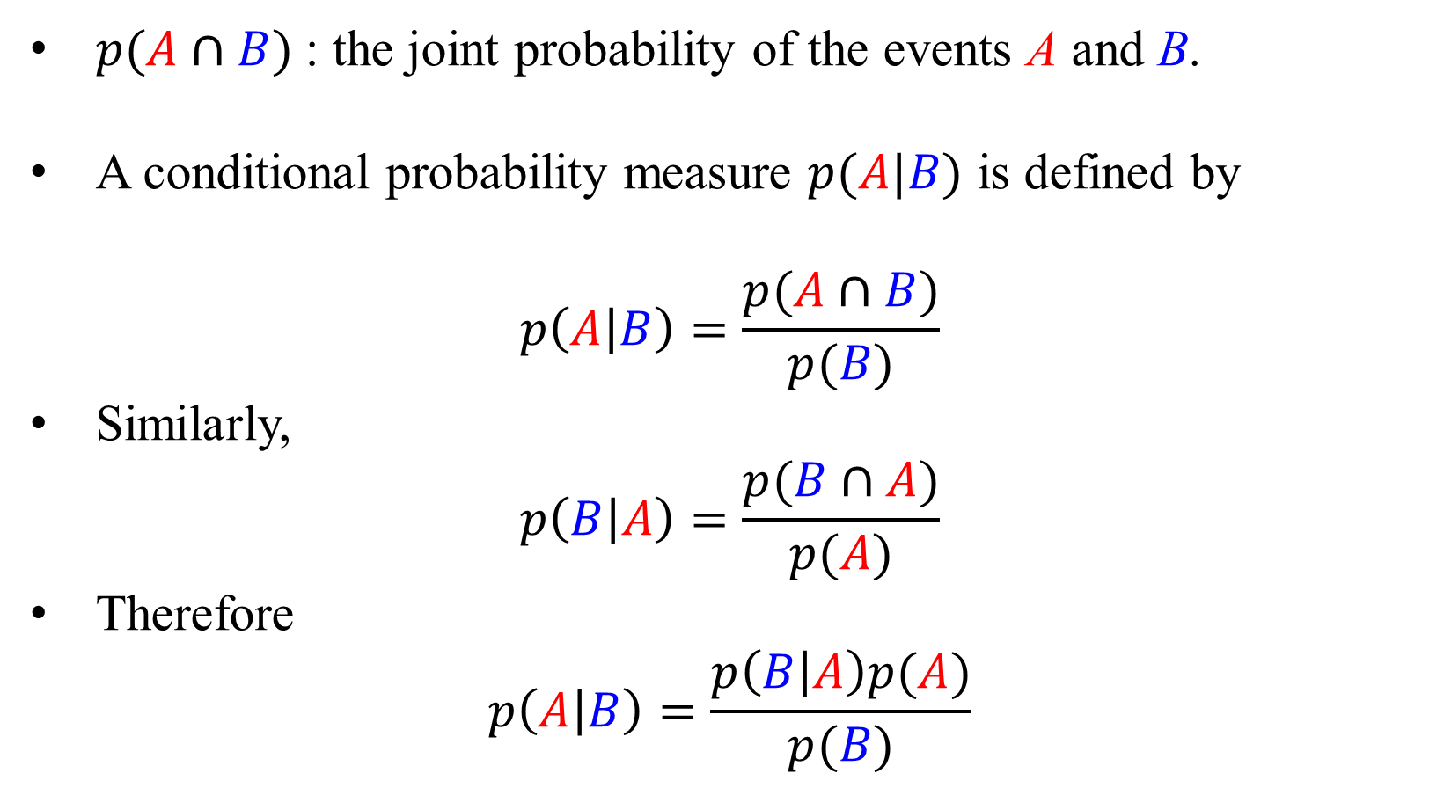
Joint, and Conditional Probability
$p(A∩B)$: the joint probability of the events A and B.
A conditional probability measure $p(A|B)$ is defined by
$$p\left(A | B\right)=\frac{p(A∩B)}{p(B)}$$
Similarly,
$$p\left(B | A\right)=\frac{p(B∩A)}{p(A)}$$
Therefore
$$p\left(A | B\right)=\frac{p\left(B | A\right)p(A)}{p(B)}$$

Slide 24
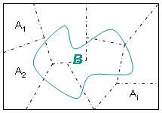
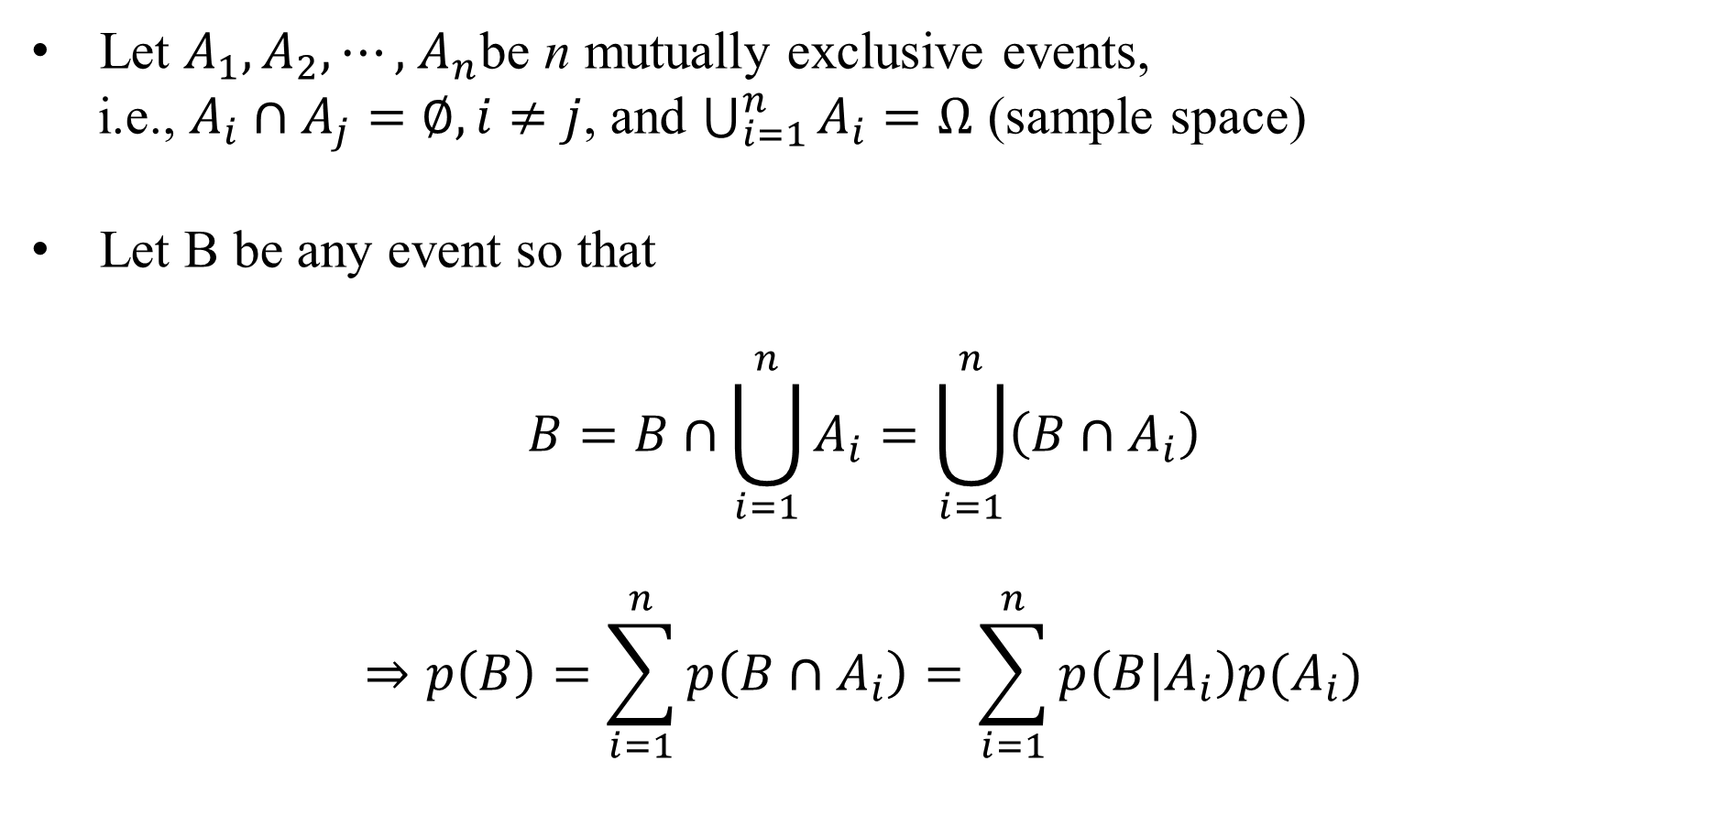
Total Probability
Let $A_{1},A_{2}, ⋯,$ $A_{n}$be n mutually exclusive events,
i.e., $A_{i}∩A_{j}=∅, i≠j$, and $\bigcup_{i=1}^{n}{A_{i}}=Ω$ (sample space)
Let B be any event so that
$$B=B∩\bigcup_{i=1}^{n}{A_{i}}=\bigcup_{i=1}^{n}{\left(B∩A_{i}\right)}$$
$$⇒p\left(B\right)=\sum_{i=1}^{n}{p\left(B∩A_{i}\right)}=\sum_{i=1}^{n}{p\left(B|A_{i}\right)p(A_{i})}$$

Slide 25
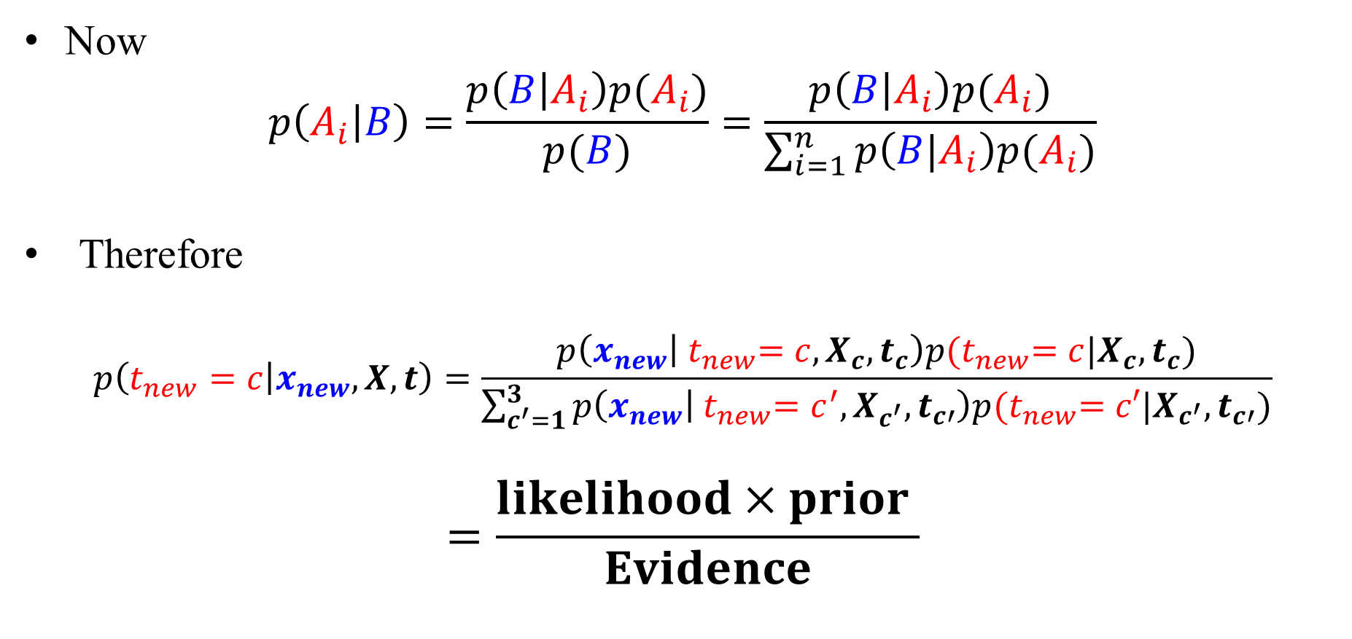
Bayes’ Theorem
Now
$$p\left(A_{i} | B\right)=\frac{p\left(B | A_{i}\right)p(A_{i})}{p(B)}=\frac{p\left(B | A_{i}\right)p(A_{i})}{\sum_{i=1}^{n}{p\left(B|A_{i}\right)p(A_{i})}}$$
Therefore
$$p\left(t_{new}=c | x_{new},X,t\right)=\frac{p\left(x_{new} | { t}_{new}=c,X_{c},t_{c}\right)p{(t}_{new}=c|X_{c},t_{c})}{\sum_{c^{′}=1}^{3}{p\left(x_{new} | { t}_{new}=c^{′},X_{c^{′}},t_{c′}\right)p{(t}_{new}=c′|X_{c^{′}},t_{c′})}}$$
$$=\frac{likelihood×prior }{Evidence}$$
Notes:
The prior distribution $p\left(θ\right)$, which encodes our beliefs about the parameters before we observe the data
The posteriori distribution $p\left(θ | X\right)$ updates “knowledge” about the statistical properties of $θ$, after having observed the data set X.

Slide 26
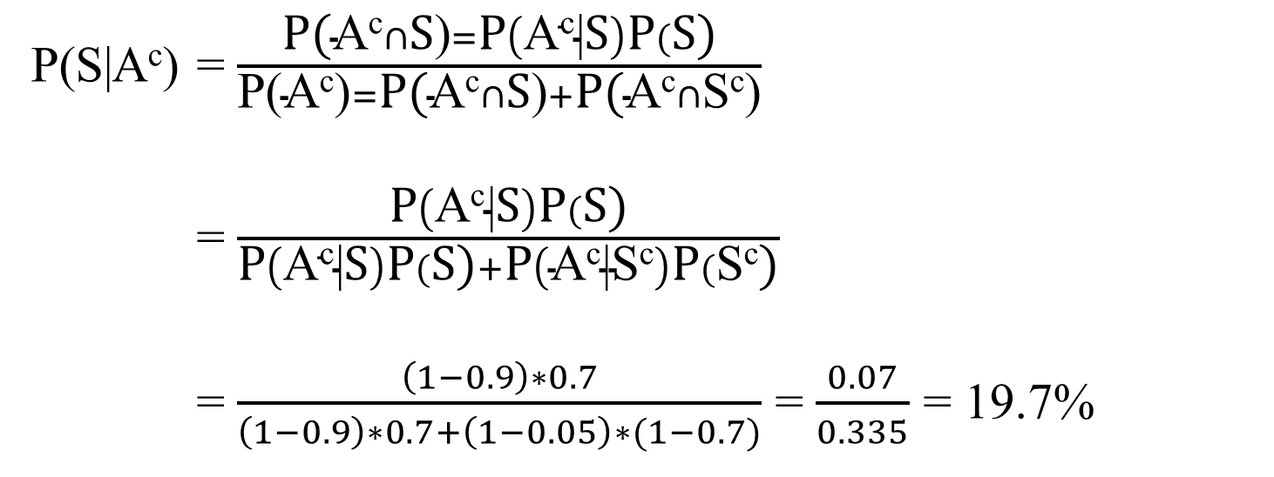
Example
Assume a certain class is given a midterm exam.
S : the event that a student studied, P(S)=0.7
P( a student pass the exam | S )= P(A|S)=0.9
P( a student pass the exam | S^{c} )= P(A|S^{c})=0.05
Given that a student did not pass the exam, what is the probability that she or he studied?
P(S|A^{c}) = $\frac{\text{P}\text{(}\text{A}\text{c}∩\text{S}\text{)}=\text{P}\left(\text{A}\text{c}\text{|}\text{S}\right)\text{P}(\text{S}\text{)}}{\text{P}\text{(}\text{Ac}\text{)}=\text{P}\text{(}\text{A}\text{c}∩\text{S}\text{)}+\text{P}\text{(}\text{A}\text{c}∩\text{S}\text{c}\text{)}}$
= $\frac{\text{P}\left(\text{A}\text{c}\text{|}\text{S}\right)\text{P}(\text{S}\text{)}}{\text{P}\left(\text{A}\text{c}\text{|}\text{S}\right)\text{P}(\text{S}\text{)}+\text{P}\left(\text{A}\text{c}\text{|}\text{Sc}\right)\text{P}(\text{S}\text{c}\text{)}}$
= $\frac{\left(1−0.9\right)∗0.7}{\left(1−0.9\right)∗0.7+\left(1−0.05\right)∗(1−0.7)}$ = $\frac{0.07}{0.335}$ = 19.7%

Slide 27
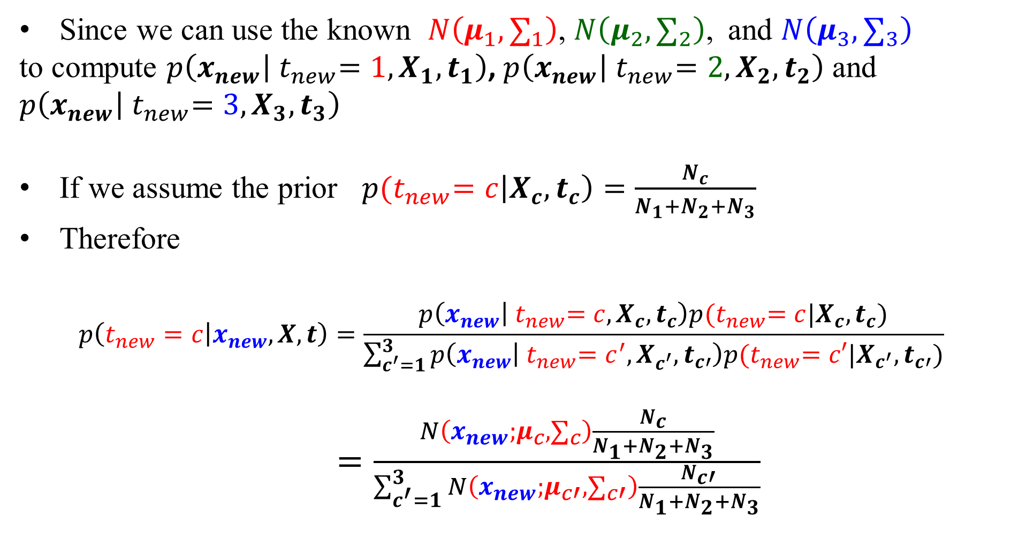
Making prediction
Since we can use the known $N\left(μ_{1}, ∑_{1}\right)$, $N\left(μ_{2}, ∑_{2}\right)$, and $N\left(μ_{3}, ∑_{3}\right)$
to compute $p\left(x_{new} | { t}_{new}=1, X_{1},t_{1}\right)$, $p\left(x_{new} | { t}_{new}=2,X_{2},t_{2}\right)$ and $p\left(x_{new} | { t}_{new}=3,X_{3},t_{3}\right)$
If we assume the prior $p{(t}_{new}=c\left|X_{c},t_{c}\right)=\frac{N_{c}}{N_{1}+N_{2}+N_{3}}$
Therefore
$$p\left(t_{new}=c | x_{new},X,t\right)=\frac{p\left(x_{new} | { t}_{new}=c,X_{c},t_{c}\right)p{(t}_{new}=c|X_{c},t_{c})}{\sum_{c^{′}=1}^{3}{p\left(x_{new} | { t}_{new}=c^{′},X_{c^{′}},t_{c′}\right)p{(t}_{new}=c′|X_{c^{′}},t_{c′})}}$$
$=\frac{N\left(x_{new};μ_{c}, ∑_{c}\right)\frac{N_{c}}{N_{1}+N_{2}+N_{3}}}{\sum_{c^{′}=1}^{3}{N\left(x_{new};μ_{c′}, ∑_{c′}\right)\frac{N_{c′}}{N_{1}+N_{2}+N_{3}}}}$

Slide 28
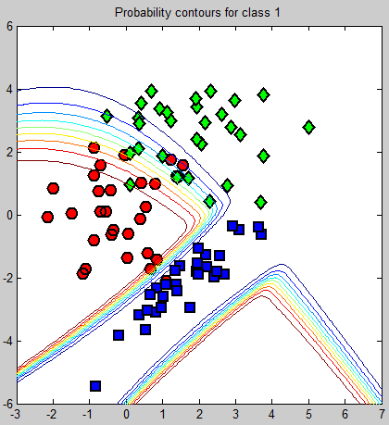
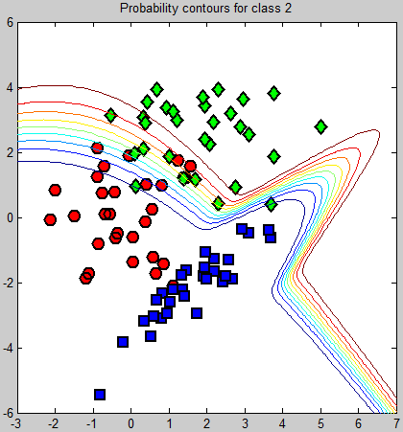
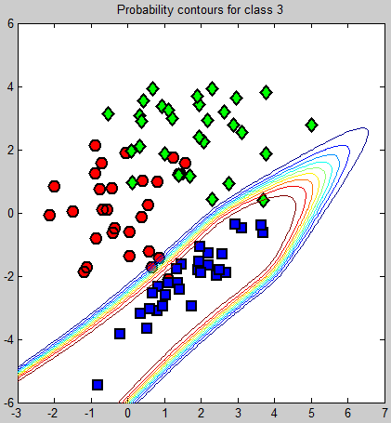
Making prediction (bayesclass.m)

Slide 29
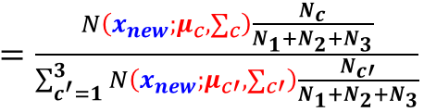
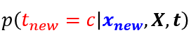
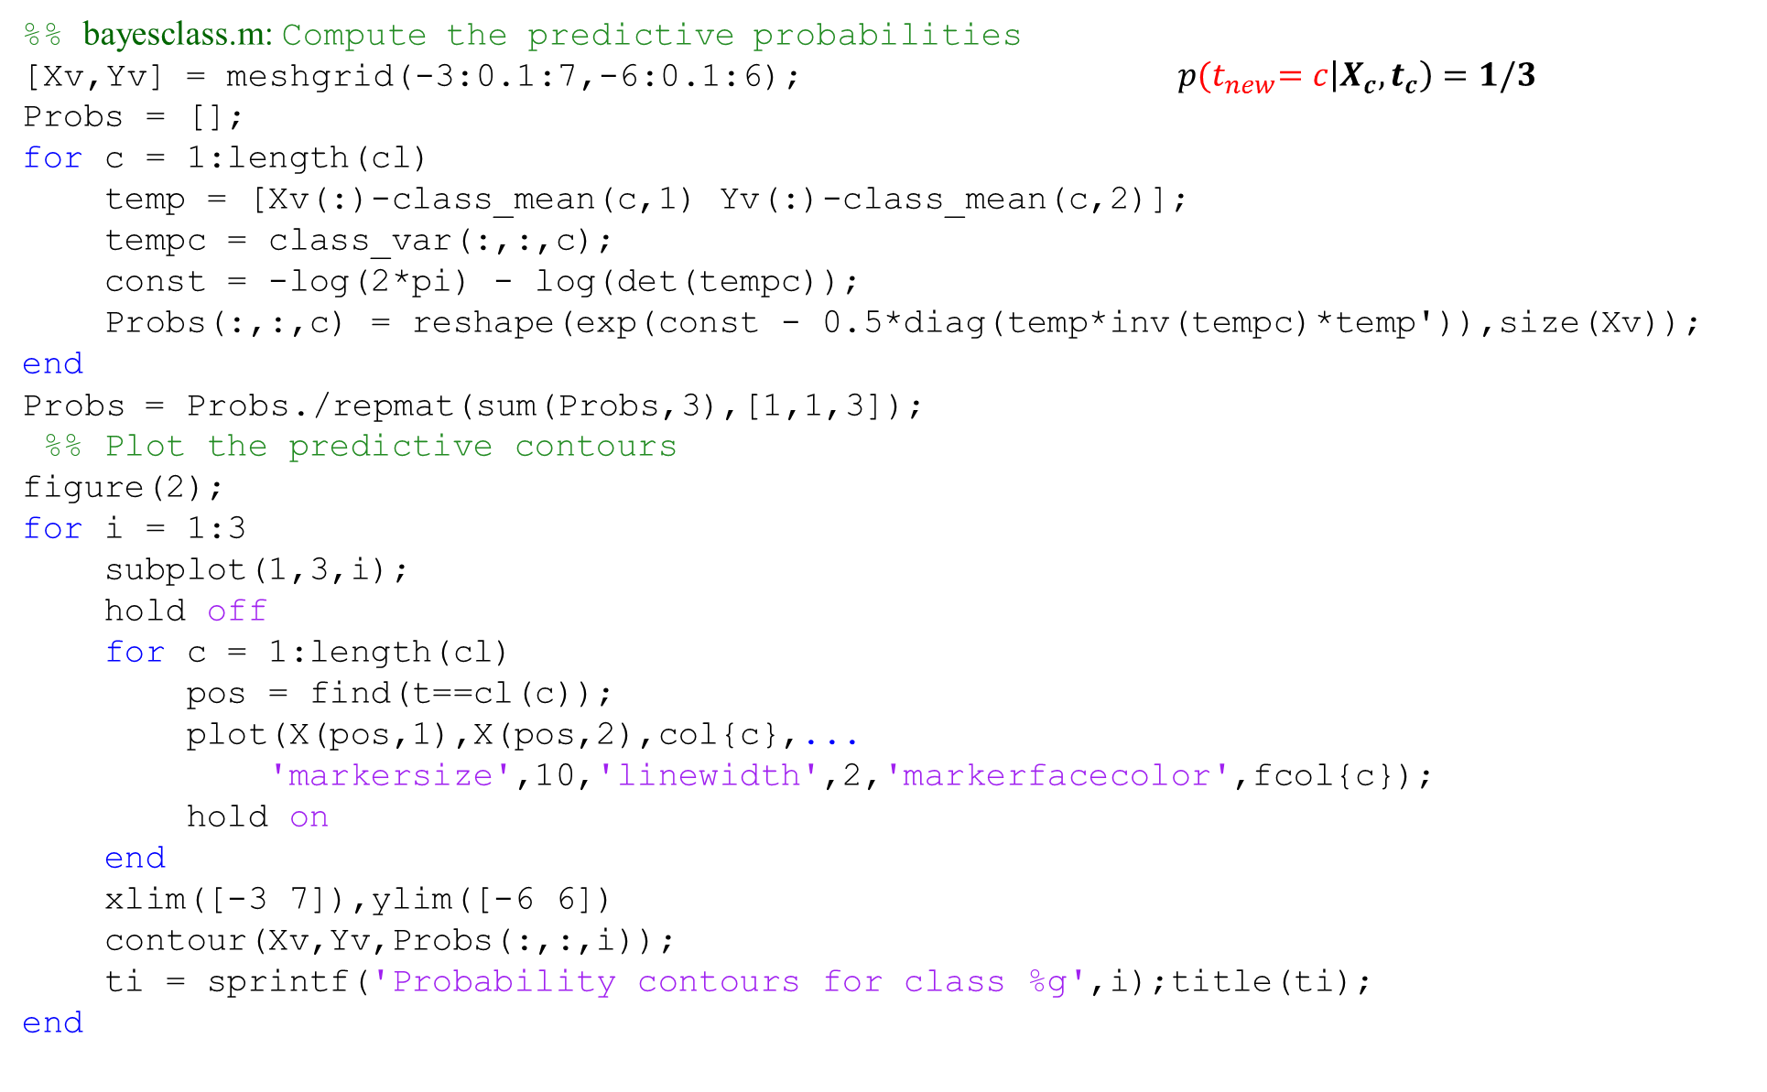
%% bayesclass.m: Compute the predictive probabilities
[Xv,Yv] = meshgrid(-3:0.1:7,-6:0.1:6); $p{(t}_{new}=c\left|X_{c},t_{c}\right)=1/3$
Probs = [];
for c = 1:length(cl)
temp = [Xv(:)-class_mean(c,1) Yv(:)-class_mean(c,2)];
tempc = class_var(:,:,c);
const = -log(2*pi) - log(det(tempc));
Probs(:,:,c) = reshape(exp(const - 0.5*diag(temp*inv(tempc)*temp')),size(Xv));
end
Probs = Probs./repmat(sum(Probs,3),[1,1,3]);
%% Plot the predictive contours
figure(2);
for i = 1:3
subplot(1,3,i);
hold off
for c = 1:length(cl)
pos = find(t==cl(c));
plot(X(pos,1),X(pos,2),col{c},...
'markersize',10,'linewidth',2,'markerfacecolor',fcol{c});
hold on
end
xlim([-3 7]),ylim([-6 6])
contour(Xv,Yv,Probs(:,:,i));
ti = sprintf('Probability contours for class %g',i);title(ti);
end

Slide 30

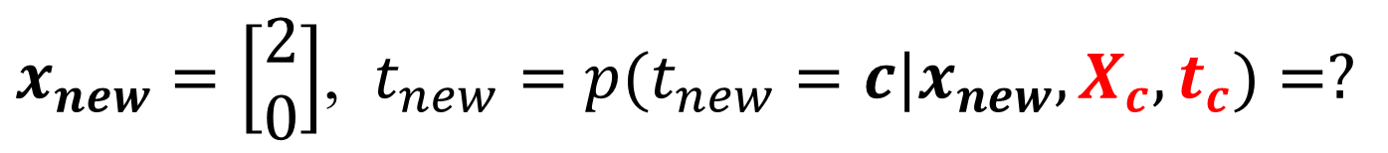


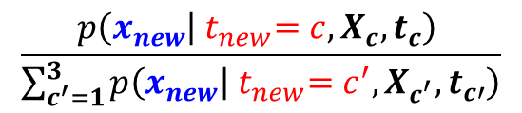
$x_{new}=\left[\begin{matrix}2 \\ 0\end{matrix}\right]$, $t_{new}=$ $p(t_{new}=c{|x}_{new},X_{c},t_{c})=?$
$c p\left(x_{new} | { t}_{new}=c,X_{c},t_{c}\right) p{(t}_{new}=c\left|X_{c},t_{c}\right)$
$$\frac{p\left(x_{new} | { t}_{new}=c,X_{c},t_{c}\right) }{\sum_{c^{′}=1}^{3}{p\left(x_{new} | { t}_{new}=c^{′},X_{c^{′}},t_{c′}\right)}}$$
$$1$$
0.0109
0.0042
0.0003
0.333
0.333
0.333
0.7072
0.2741
0.0187
$$2$$
$$3$$
bayesclass_x_new.m

Slide 31
%% bayesclass_x_new.m: Repeat without Naive assumption
class_var = [];
for c = 1:length(cl)
pos = find(t==cl(c));
% Find the means
class_mean(c,:) = mean(X(pos,:));
class_var(:,:,c) = cov(X(pos,:),1);
end
%% Compute the predictive probabilities
Xv=2;
Yv=0 ;
Probs = [];
for c = 1:length(cl)
temp = [Xv(:)-class_mean(c,1) Yv(:)-class_mean(c,2)];
tempc = class_var(:,:,c);
const = -log(2*pi) - log(det(tempc));
Probs(:,:,c) = reshape(exp(const - 0.5*diag(temp*inv(tempc)*temp')),size(Xv));
end
[Probs(:,:,1) Probs(:,:,2) Probs(:,:,3) sum(Probs,3)]% 分子 與 分母
Probs = Probs./repmat(sum(Probs,3),[1,1,3])

Slide 32
The naive-Bayes assumption

Slide 33
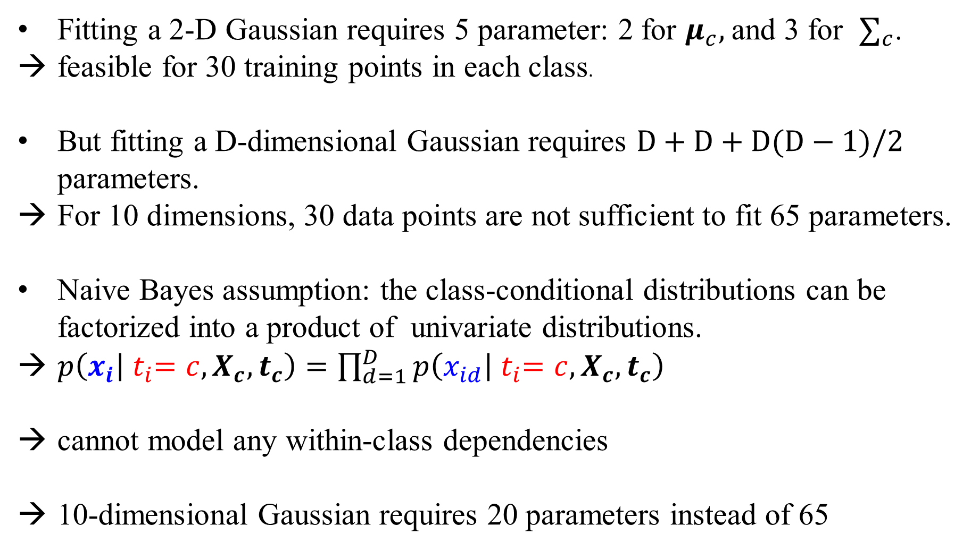
The naive-Bayes assumption
Fitting a 2-D Gaussian requires 5 parameter: 2 for $μ_{c},$and 3 for $∑_{c}$.
feasible for 30 training points in each class.
But fitting a D-dimensional Gaussian requires $D+D+D(D−1)/2$ parameters.
For 10 dimensions, 30 data points are not sufficient to fit 65 parameters.
Naive Bayes assumption: the class-conditional distributions can be factorized into a product of univariate distributions.
$p\left(x_{i} | { t}_{i}=c,X_{c},t_{c}\right)=\prod_{d=1}^{D}{p\left(x_{id} | { t}_{i}=c,X_{c},t_{c}\right)}$
cannot model any within-class dependencies
10-dimensional Gaussian requires 20 parameters instead of 65

Slide 34
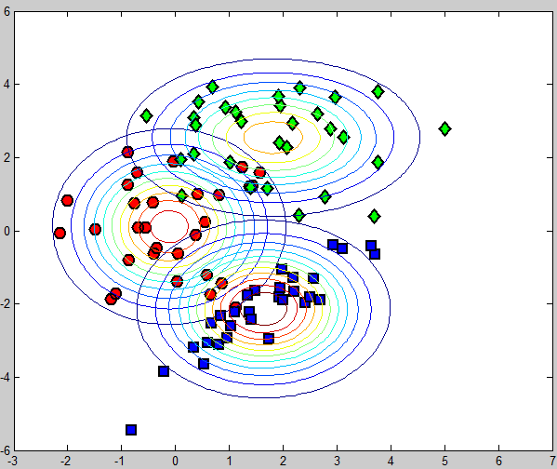
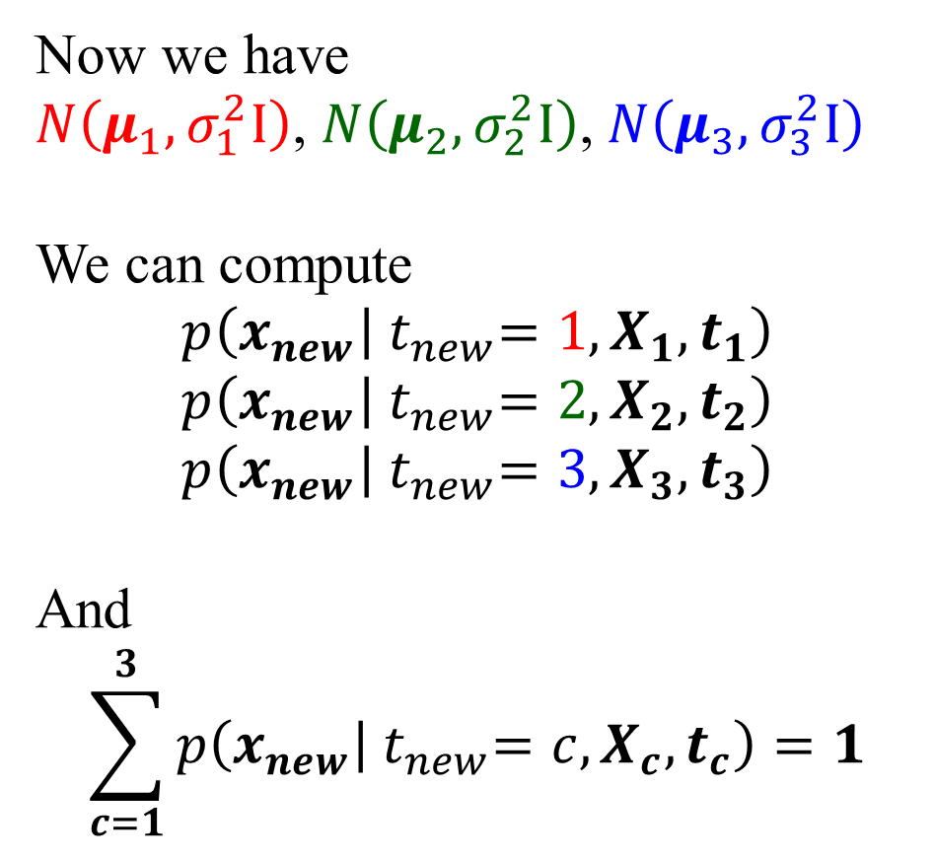
Maximum Likelihood: An example with three classes
Now we have
$N\left(μ_{1},σ_{1}^{2}I\right)$, $N\left(μ_{2},σ_{2}^{2}I\right)$, $N\left(μ_{3},σ_{3}^{2}I\right)$
We can compute
$$p\left(x_{new} | { t}_{new}=1, X_{1},t_{1}\right)$$
$$p\left(x_{new} | { t}_{new}=2,X_{2},t_{2}\right)$$
$$p\left(x_{new} | { t}_{new}=3,X_{3},t_{3}\right)$$
And
$$\sum_{c=1}^{3}{p\left(x_{new} | { t}_{new}=c,X_{c},t_{c}\right)}=1$$
plotcc.m

Slide 35
%% Fit class-conditional Gaussians for each class
% Using the Naive (independence) assumption
for c = 1:length(cl)
pos = find(t==cl(c));
% Find the means
class_mean(c,:) = mean(X(pos,:));
class_var(c,:) = var(X(pos,:),1);
end
%% Plot the contours
[Xv,Yv] = meshgrid(-3:0.1:7,-6:0.1:6);
for c = 1:length(cl)
temp = [Xv(:)-class_mean(c,1) Yv(:)-class_mean(c,2)];
tempc = diag(class_var(c,:));
const = -log(2*pi) - log(det(tempc));
Probs = exp(const - 0.5*diag(temp*inv(tempc)*temp'));
contour(Xv,Yv,reshape(Probs,size(Xv)));
end

Slide 36
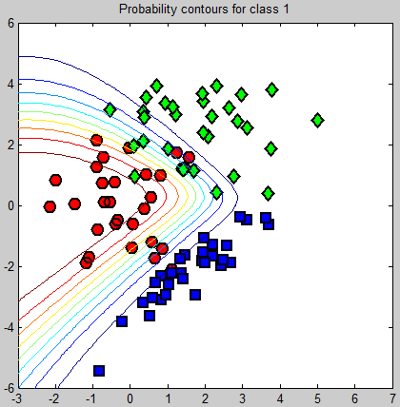
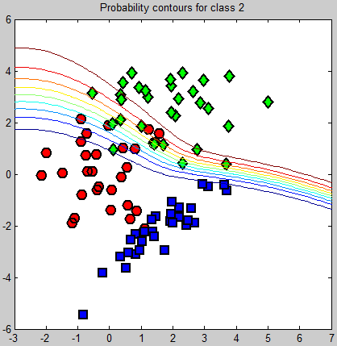
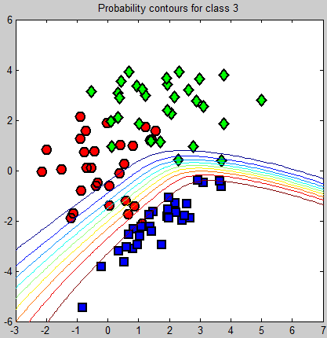
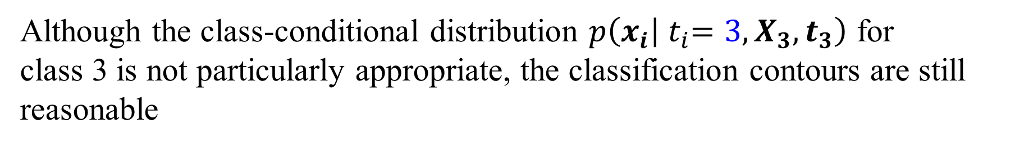
Making prediction (bayesclass_naive.m)
Although the class-conditional distribution $p\left(x_{i} | { t}_{i}=3,X_{3},t_{3}\right)$ for
class 3 is not particularly appropriate, the classification contours are still reasonable

Slide 37
%% Compute the predictive probabilities
[Xv,Yv] = meshgrid(-3:0.1:7,-6:0.1:6);
Probs = [];
for c = 1:length(cl)
temp = [Xv(:)-class_mean(c,1) Yv(:)-class_mean(c,2)];
tempc = diag(class_var(c,:));
const = -log(2*pi) - log(det(tempc));
Probs(:,:,c) = reshape(exp(const - 0.5*diag(temp*inv(tempc)*temp')),size(Xv));
end
Probs = Probs./repmat(sum(Probs,3),[1,1,3]);
%% Plot the predictive contours
for i = 1:3
subplot(1,3,i);
for c = 1:length(cl)
pos = find(t==cl(c));
plot(X(pos,1),X(pos,2),col{c},...
'markersize',10,'linewidth',2,'markerfacecolor',fcol{c});
hold on
end
xlim([-3 7]), ylim([-6 6])
contour(Xv,Yv,Probs(:,:,i));
ti = sprintf('Probability contours for class %g',i);
title(ti);
end

Slide 38
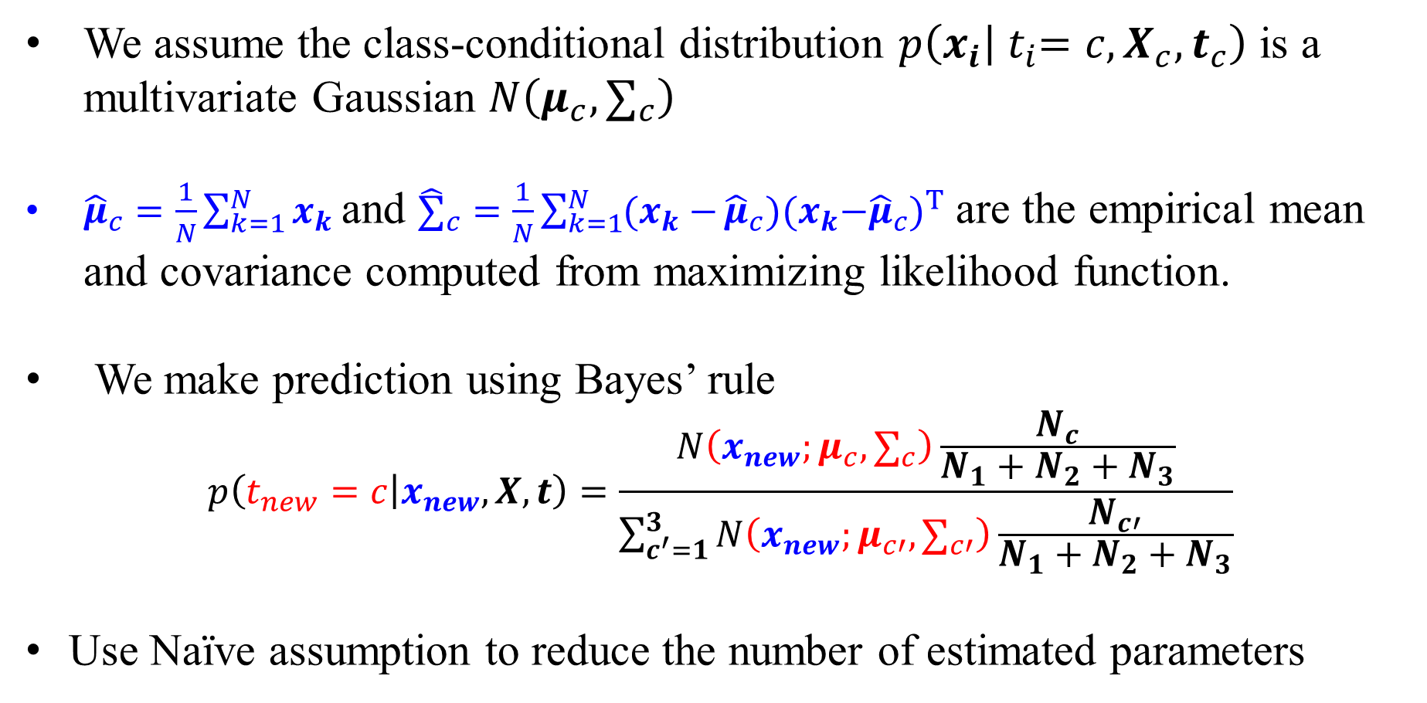
Summary
We assume the class-conditional distribution $p\left(x_{i} | { t}_{i}=c,X_{c},t_{c}\right)$ is a multivariate Gaussian $N\left(μ_{c}, ∑_{c}\right)$
${\hat{μ}}_{c}=\frac{1}{N}\sum_{k=1}^{N}{x_{k}}$ and ${\hat{∑}}_{c}=\frac{1}{N}\sum_{k=1}^{N}{(x_{k}−}{\hat{μ}}_{c}){{(x}_{k}−{\hat{μ}}_{c})}^{T}$ are the empirical mean and covariance computed from maximizing likelihood function.
We make prediction using Bayes’ rule
$$p\left(t_{new}=c | x_{new},X,t\right)=\frac{N\left(x_{new};μ_{c}, ∑_{c}\right)\frac{N_{c}}{N_{1}+N_{2}+N_{3}}}{\sum_{c^{′}=1}^{3}{N\left(x_{new};μ_{c′}, ∑_{c′}\right)\frac{N_{c′}}{N_{1}+N_{2}+N_{3}}}}$$
Use Naïve assumption to reduce the number of estimated parameters

Slide 39
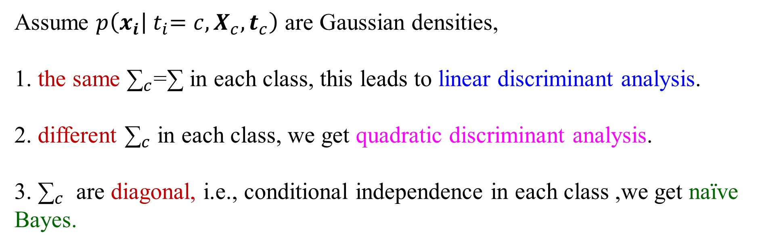
Remark: Discriminant Analysis
Assume $p\left(x_{i} | { t}_{i}=c,X_{c},t_{c}\right)$ are Gaussian densities,
1. the same ${\text{∑}}_{c}$=∑ in each class, this leads to linear discriminant analysis.
2. different ${\text{∑}}_{c}$ in each class, we get quadratic discriminant analysis.
3. ${\text{∑}}_{c}$ are diagonal, i.e., conditional independence in each class ,we get naïve Bayes.

Slide 40
Naïve Bayes for text classification

Slide 41
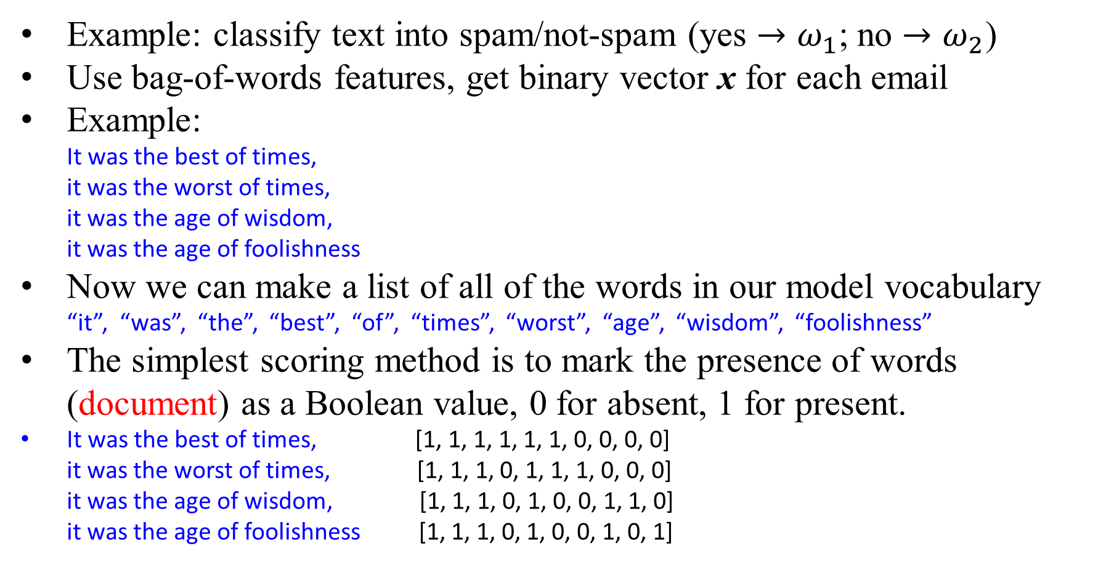
Example: Classifying Text into Spam/Not-spam
Example: classify text into spam/not-spam (yes ${→ω}_{1}$; no ${→ω}_{2}$)
Use bag-of-words features, get binary vector x for each email
Example:
It was the best of times, it was the worst of times, it was the age of wisdom, it was the age of foolishness
Now we can make a list of all of the words in our model vocabulary
“it”, “was”, “the”, “best”, “of”, “times”, “worst”, “age”, “wisdom”, “foolishness”
The simplest scoring method is to mark the presence of words (document) as a Boolean value, 0 for absent, 1 for present.
It was the best of times, [1, 1, 1, 1, 1, 1, 0, 0, 0, 0] it was the worst of times, [1, 1, 1, 0, 1, 1, 1, 0, 0, 0] it was the age of wisdom, [1, 1, 1, 0, 1, 0, 0, 1, 1, 0] it was the age of foolishness [1, 1, 1, 0, 1, 0, 0, 1, 0, 1]

Slide 42
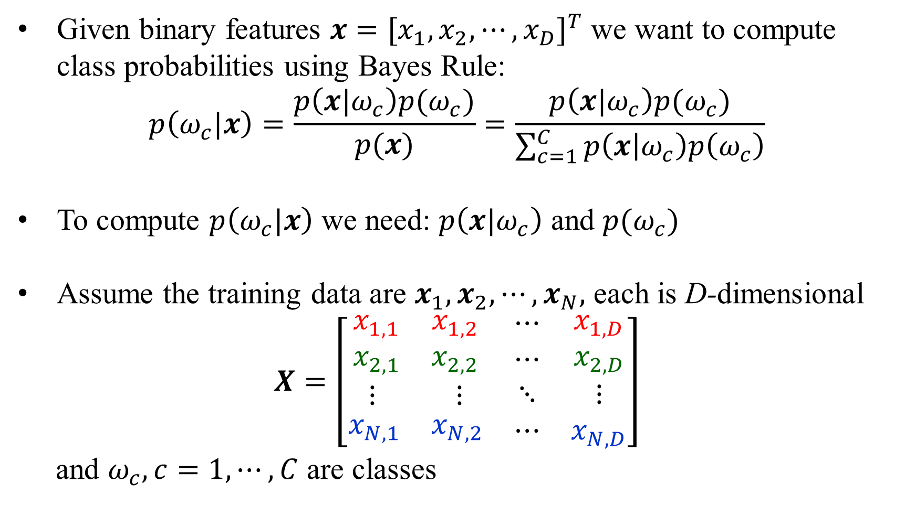
Bayes Classifier
Given binary features $x={[x_{1},x_{2},⋯,x_{D}]}^{T}$ we want to compute class probabilities using Bayes Rule:
$$p\left(ω_{c}|x\right)=\frac{p\left(x|ω_{c}\right)p(ω_{c})}{p(x)}=\frac{p\left(x|ω_{c}\right)p(ω_{c})}{\sum_{c=1}^{C}{p\left(x | ω_{c}\right)p\left(ω_{c}\right)}}$$
To compute $p\left(ω_{c}|x\right)$ we need: $p\left(x|ω_{c}\right)$ and $p(ω_{c})$
Assume the training data are $x_{1},x_{2},⋯,x_{N},$ each is D-dimensional
$$X=\left[\begin{matrix}\begin{matrix}x_{1,1} & x_{1,2} \\ x_{2,1} & x_{2,2}\end{matrix} & \begin{matrix}⋯ \\ ⋯\end{matrix} & \begin{matrix}x_{1,D} \\ x_{2,D}\end{matrix} \\ \begin{matrix}⋮ & ⋮\end{matrix} & ⋱ & ⋮ \\ \begin{matrix}x_{N,1} & x_{N,2}\end{matrix} & ⋯ & x_{N,D}\end{matrix}\right]$$
and $ω_{c}, c=1,⋯,C$ are classes

Slide 43
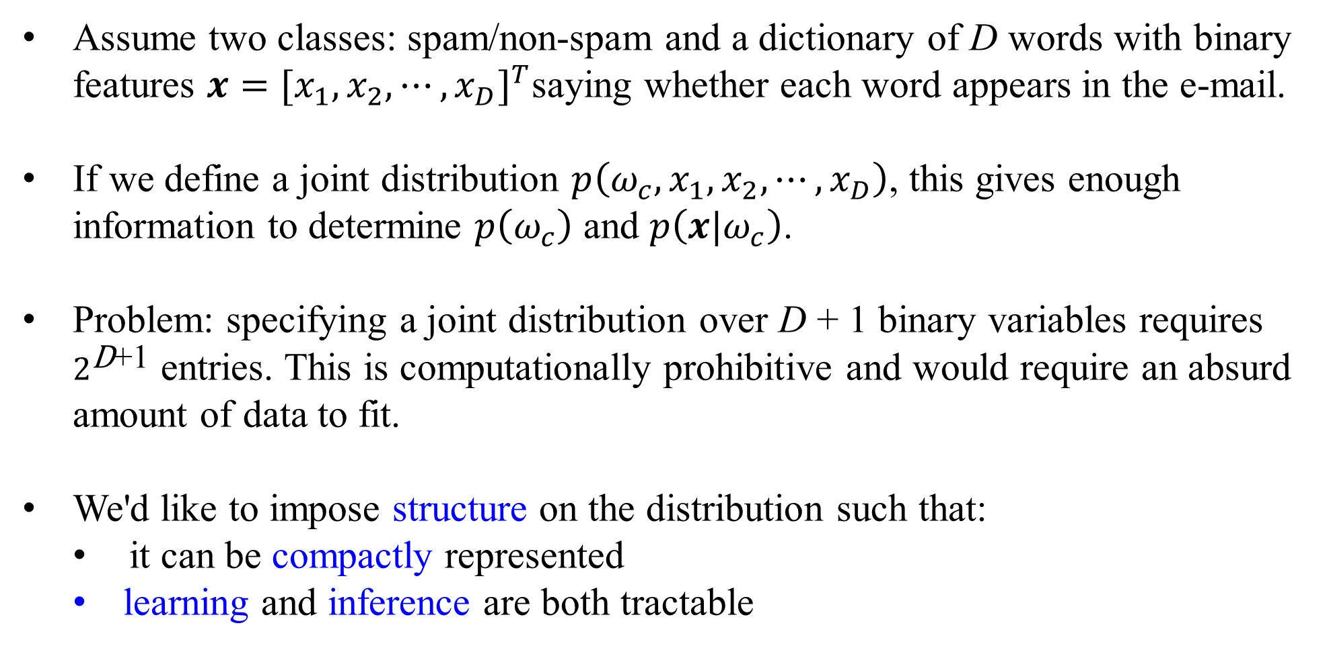
Naïve Bayes
Assume two classes: spam/non-spam and a dictionary of D words with binary features $x={[x_{1},x_{2},⋯,x_{D}]}^{T}$saying whether each word appears in the e-mail.
If we define a joint distribution $p\left(ω_{c},x_{1},x_{2},⋯,x_{D}\right)$, this gives enough information to determine $p\left(ω_{c}\right)$ and $p\left(x|ω_{c}\right)$.
Problem: specifying a joint distribution over D + 1 binary variables requires $2^{\text{D}\text{+1}}$ entries. This is computationally prohibitive and would require an absurd amount of data to fit.
We'd like to impose structure on the distribution such that:
it can be compactly represented
learning and inference are both tractable

Slide 44

Naïve Bayes
Naïve Bayes makes the assumption that the word features $x_{i}$ are conditionally independent given the class $ω_{c}$.
$x_{i}$ and $x_{j}$ are independent under the conditional distribution $p\left(x|ω_{c}\right)$.
Mathematically,
$$p\left(ω_{c},x_{1},x_{2},⋯,x_{D}\right)=p\left(ω_{c}\right)p\left(x_{1},x_{2},⋯,x_{D} | ω_{c}\right)$$
$=p\left(ω_{c}\right)p(x_{1}|ω_{c})⋯p(x_{D}|ω_{c})$
Compact representation of the joint distribution
Prior probability of class: $p\left(ω_{c}\right)=θ_{ω_{c}}$
Conditional probability of word feature given class: $p\left(x_{j} | ω_{c}\right)=θ_{jω_{c}}$
2D + 1 parameters in total

Slide 45

Naïve Bayes: Learning
The parameters can be learned efficiently because the log-likelihood decomposes into independent terms for each feature.
$$L\left(θ\right)=\sum_{i=1}^{N}{\log{p(ω_{i,c}, x_{i})}}=\sum_{i=1}^{N}{\log{\{p(ω_{i,c})}}\prod_{j=1}^{D}{p\left(x_{i,j} | ω_{i,c}\right)}\}$$
$$=\sum_{i=1}^{N}{\log{p(ω_{i,c})}}+\sum_{j=1}^{D}{\sum_{i=1}^{N}{\log{p\left(x_{i,j} | ω_{i,c}\right)}}}$$
$$=\text{Bernoulli} \text{log}\text{−}\text{likelihood} \text{of} \text{labels}+\sum_{j=1}^{D}{\text{Bernoulli} \text{log}\text{−}\text{likelihood} for feature x_{j}}$$
Each of these log-likelihood terms depends on different sets of parameters, so they can be optimized independently
We want to maximize $\sum_{i=1}^{N}{\log{p\left(x_{i,j} | ω_{i,c}\right)}}$

Slide 46

Naïve Bayes: Making Predictions (Inference)
We predict the category by performing inference in the model.
Apply Bayes' Rule:
$$p\left(ω_{c}|x\right)=\frac{p\left(x|ω_{c}\right)p(ω_{c})}{p(x)}=\frac{p\left(x|ω_{c}\right)p(ω_{c})}{\sum_{c=1}^{C}{p(ω_{c})p\left(x|ω_{c}\right)}}=\frac{p(ω_{c})\prod_{j=1}^{D}{p(x_{j}|ω_{c})}}{\sum_{c=1}^{C}{p(ω_{c})\prod_{j=1}^{D}{p(x_{j}|ω_{c})}}}$$
We need not compute the denominator if we're simply trying to determine the mostly likely $ω_{c}$.
Shorthand notation: $p\left(ω_{c}|x\right)∝p(ω_{c})\prod_{j=1}^{D}{p(x_{j}|ω_{c})}$
Given the value of x, its class is decided by the likelihood ratio
$$l_{12}=\frac{{p(x|ω}_{1 }){p(ω}_{1 })}{{p(x|ω}_{2 }){p(ω}_{2 })}\begin{matrix}\begin{matrix}ω_{1} \\ >\end{matrix} \\ \begin{matrix}< \\ ω_{2}\end{matrix}\end{matrix} 1$$

Slide 47

Example: The spam/not-spam case
Consider the binary bag-of-words vector $x={[x_{1},x_{2},⋯,x_{d}]}^{T}$, $x_{j}$ $∈\left\{0,1\right\}, j=1, 2, ⋯,D$. Two classes: yes ${→ω}_{1}$; no ${→ω}_{2}$, $p\left(ω_{c}\right)$ are assumed given
$N_{a,b}$ is the counts for $x_{j}=a∈\left\{0,1\right\},$and $ω_{c}=b∈\left\{ω_{1},ω_{2}\right\}$
Let ${p(x}_{j}=1\left|ω_{1}\right)=p_{j}=\frac{N_{1,ω_{1}}}{N_{0,ω_{1}}+N_{1,ω_{1}}}$ and ${p(x}_{j}=1\left|ω_{2}\right)=q_{j}=\frac{N_{1,ω_{2}}}{N_{0,ω_{2}}+N_{1,ω_{2}}}$
$ω_{1}$: it was the best of times, $x_{1}$=[1, 1, 1, 1, 1, 1, 0, 0, 0, 0] it was the worst of times, $x_{2}$=[1, 1, 1, 0, 1, 1, 1, 0, 0, 0]
$p_{1}=p_{2}=p_{3}=p_{5}=p_{6}=\frac{2}{12},p_{4}=p_{7}=\frac{1}{12},p_{8}=p_{9}=p_{10}=\frac{0}{12}$
$ω_{2}$: it was the age of wisdom, $x_{3}$=[1, 1, 1, 0, 1, 0, 0, 1, 1, 0] it was the age of foolishness $x_{4}$=[1, 1, 1, 0, 1, 0, 0, 1, 0, 1]
$q_{1}=q_{2}=q_{3}=q_{5}=q_{8}=\frac{2}{12},q_{9}=q_{10}=\frac{1}{12},q_{4}=q_{6}=q_{7}=\frac{0}{12}$

Slide 48

Example: The discrete features case
${p(x}_{j}=1\left|ω_{1}\right)=p_{j},{p(x}_{j}=1\left|ω_{2}\right)=q_{j}$
However, adopting statistical independence among features, we can write
$${p(x|ω}_{1 })=\prod_{j=1}^{D}{p_{j}^{x_{j}}}{(1−p_{j})}^{1−x_{j}},$$
$$e.g. p\left(x|ω_{1}\right)={\left[\text{1 1 1 1 1 1 0 0 0 0}\right]}^{T}=p_{1}p_{2}p_{3}p_{4}p_{5}p_{6}(1−p_{7})(1−p_{8})(1−p_{9})(1−p_{10})$$
$${p(x|ω}_{2 })=\prod_{j=1}^{D}{q_{j}^{x_{j}}}{(1−q_{j})}^{1−x_{j}}$$
Hence, the number of required estimates is 2D, that is, the $p_{j}$’s and $q_{j}$’s.

Slide 49


Example: learning $p_{j}$ and $q_{j}$ given $x_{1}, ⋯,x_{N}$
${p(x}_{j}=1\left|ω_{1}\right)=p_{j},{p(x}_{j}=1\left|ω_{2}\right)=q_{j},$
$p\left(x_{i,j} | ω_{1}\right)=p_{j}^{x_{i,j}}{(1−p_{j})}^{1−x_{i,j}}$, $p\left(x_{i,j} | ω_{2}\right)=q_{j}^{x_{i,j}}{(1−q_{j})}^{1−x_{i,j}}$
Log-likelihood:
$$\log{\prod_{i=1}^{N}{p\left(x_{i,j} | ω_{1}\right)}}=\sum_{i=1}^{N}{\log{p\left(x_{i,j} | ω_{1}\right)}}=\sum_{i=1}^{N_{1,ω_{1}}}{x_{i,j}\log{p_{j}}}+\sum_{i=1}^{N_{0,ω_{1}}}{(1−x_{i,j})\log{(1−p_{j}})}=N_{1,ω_{1}}\log{p_{j}}+N_{0,ω_{1}}\log{(1−p_{j}})$$
$$\log{\prod_{i=1}^{N}{p\left(x_{i,j} | ω_{2}\right)}}=\sum_{i=1}^{N}{\log{p\left(x_{i,j} | ω_{2}\right)}}=\sum_{i=1}^{N_{1,ω_{2}}}{x_{i,j}\log{q_{j}}}+\sum_{i=1}^{N_{0,ω_{2}}}{(1−x_{i,j})\log{(1−q_{j}})}=N_{1,ω_{2}}\log{q_{j}}+N_{0,ω_{2}}\log{(1−q_{j}})$$
Obtain maximum likelihood estimates by setting derivatives to zero:
$$p_{j}=\frac{N_{1,ω_{1}}}{N_{0,ω_{1}}+N_{1,ω_{1}}}, q_{j}=\frac{N_{1,ω_{2}}}{N_{0,ω_{2}}+N_{1,ω_{2}}}$$

Slide 50

Example: Making Predictions (Inference)
Given the value of x, its class is decided by the likelihood ratio
$$l_{12}=\frac{{p(x|ω}_{1 }){p(ω}_{1 })}{{p(x|ω}_{2 }){p(ω}_{2 })}\begin{matrix}\begin{matrix}ω_{1} \\ >\end{matrix} \\ \begin{matrix}< \\ ω_{2}\end{matrix}\end{matrix} 1$$
The number of values that x can take, for all possible combinations of $x_{j}$ , amounts to $2^{D}$ .
If we do not adopt independence assumption, one must have enough training data to obtain probability estimates for each one of these values (probabilities add to one, thus $2^{D}−1$ estimates are required).

Slide 51

Example: Making Predictions (Inference)
The linear discriminant function for decision boundary:
$$\frac{{p(x|ω}_{1 }){p(ω}_{1 })}{{p(x|ω}_{2 }){p(ω}_{2 })}=\frac{\prod_{j=1}^{D}{p_{j}^{x_{j}}}{(1−p_{j})}^{1−x_{j}}{p(ω}_{1 })}{\prod_{j=1}^{D}{q_{j}^{x_{j}}}{(1−q_{j})}^{1−x_{j}}{p(ω}_{2 })}=\begin{matrix}\begin{matrix}ω_{1} \\ >\end{matrix} \\ \begin{matrix}< \\ ω_{2}\end{matrix}\end{matrix} 1=1$$
$$\log{\prod_{j=1}^{D}{p_{j}^{x_{j}}}{(1−p_{j})}^{1−x_{j}}{p(ω}_{1 }) }=\log{\prod_{j=1}^{D}{q_{j}^{x_{j}}}{(1−q_{j})}^{1−x_{j}}{p(ω}_{2 })}$$
$$\sum_{j=1}^{D}{\left(x_{j}\log{p_{j}}+\left(1−x_{j}\right)\log\left(1−p_{j}\right)+\log{{p(ω}_{1 })}\right)}=\sum_{i=1}^{D}{\left(x_{j}\log{q_{j}}+\left(1−x_{j}\right)\log\left(1−q_{j}\right)+\log{{p(ω}_{2 })}\right)}$$
$$0=\sum_{j=1}^{D}{\left(x_{j}\log{\frac{p_{j}}{q_{j}}}+\left(1−x_{j}\right)\log{\frac{(1−p_{j})}{(1−q_{j})}}+\log{\frac{{p(ω}_{1 })}{{p(ω}_{2 })}}\right)}≡g\left(x\right)=w^{T}x+w_{0}$$
where $w^{T}=\left[\log{\frac{p_{1}(1−q_{1})}{q_{1}(1−p_{1})}}, ⋯,\log{\frac{p_{D}(1−q_{D})}{q_{D}(1−p_{D})}}\right],w_{0}=\sum_{j=1}^{d}{\log{\frac{(1−p_{j})}{(1−q_{j})}}+\log{\frac{{p(ω}_{1 })}{{p(ω}_{2 })}}}$

Slide 52


ROC curve and AUC
AUC-ROC curve is to measure and assess the performance of classification models.
ROC (Receiver Operating Characteristics) is a pictorial visualization of model performance.
It plots a 2D probability plot between the FP rate (or 1-specificity) and the TP rate (or sensitivity).
We can also represent the area covered by a model with a single number using AUC:
Python Data Analysis, 3rd, Avinash Navlani Armando Fandango Ivan Idris, Packt Publishing, 2021

Slide 53


ROC curve and AUC
舉例來說，用血壓值來檢測一個人是否有高血壓，測出的血壓值是連續的實數（從0~200都有可能），以收縮壓140／舒張壓90為閾值，閾值以上便診斷為有高血壓，閾值未滿者診斷為無高血壓。二元分類模型的個案預測有四種結局：
真陽性（TP）：診斷為有，實際上也有高血壓。
偽陽性（FP）：診斷為有，實際卻沒有高血壓。
真陰性（TN）：診斷為沒有，實際上也沒有高血壓。
偽陰性（FN）：診斷為沒有，實際卻有高血壓。
這四種結局可以畫成2 × 2的混淆矩陣：
https://zh.wikipedia.org/wiki/ROC%E6%9B%B2%E7%BA%BF

Slide 54


ROC curve and AUC
給定一個二元分類模型和它的閾值，就能從所有樣本的（陽性／陰性）真實值和預測值計算出一個 (X=FPR, Y=TPR) 座標點。 在這條線的以上的點代表了一個好的分類結果（勝過隨機分類），而在這條線以下的點代表了差的分類結果（劣於隨機分類）。
上述ROC空間裡的單點，是給定分類模型且給定閾值後得出的。
但同一個二元分類模型的閾值可能設定為高或低，每種閾值的設定會得出不同的FPR和TPR。
https://zh.wikipedia.org/wiki/ROC%E6%9B%B2%E7%BA%BF

Slide 55


ROC curve and AUC
將同一模型每個閾值 的 (FPR, TPR) 座標都畫在ROC空間裡，就成為特定模型的ROC曲線
例如下圖，人體的血液蛋白濃度是呈常態分布的連續變數，病人的分布是紅色，平均值為A g/dL，健康人的分布是藍色，平均值是C g/dL。健康檢查會測量血液樣本中的某種蛋白質濃度，達到某個值（閾值，threshold）以上診斷為有疾病徵兆。
研究者可以調整閾值的高低（將下圖的B垂直線往左或右移動），便會得出不同的偽陽性率與真陽性率，總之即得出不同的預測準確率。
https://zh.wikipedia.org/wiki/ROC%E6%9B%B2%E7%BA%BF

Slide 56

General Case: Multinomial Distribution
Multinomial coefficient:
The number of ways in which $N$ distinct objects can be divided
into k classes of sizes $n_{1},n_{2},⋯,$ $n_{k}$, where $n_{1}+n_{2}+⋯+n_{k}=N$
Using the multiplication principle, the total number of division is
$$\left(\begin{matrix}N \\ n_{1}\end{matrix}\right)×\left(\begin{matrix}N−n_{1} \\ n_{2}\end{matrix}\right)×\left(\begin{matrix}N−n_{1}−n_{2} \\ n_{3}\end{matrix}\right)×\left(\begin{matrix}N−n_{1}−n_{2}−⋯−n_{k−1} \\ n_{k}\end{matrix}\right)=\frac{N!}{n_{1}!×⋯n_{k}!}$$
Example : In a class of 25 students, the instructor wants
project1 : a group of 10
project2 : a group of 8
project3 : a group of 7
How many possible ways can the instructor assign
the students to the three projects?
sol : $\left(\begin{matrix}25 \\ 10\end{matrix}\right)×\left(\begin{matrix}15 \\ 8\end{matrix}\right)×\left(\begin{matrix}7 \\ 7\end{matrix}\right)=\frac{25!}{10!×8!×7!}=956112300$

Slide 57
General Case: Multinomial Distribution
Imagine you were building a machine that produces random documents of N words and you wanted to define a distribution over these documents
One way of representing a document would be with a vector of word counts.
Assuming D possible words in the vocabulary, the vector would be of length D and the jth element would hold the number of times the jth word appears in the document.
Example: : it was the best of times and worst of times . (N=10)
it was the age of wisdom and age of foolishness. (N=10)
Now we can make a list of all of the words in our model vocabulary
“it”, “was”, “the”, “best”, “of”, “times”, “and”, “worst”, “age”, “wisdom”, “foolishness” (D=11)

Slide 58

General Case: Multinomial Distribution
Example: : it was the best of times and worst of times . (N=10)
it was the age of wisdom and age of foolishness. (N=10)
Now we can make a list of all of the words in our model vocabulary
“it”, “was”, “the”, “best”, “of”, “times”, “and”, “worst”, “age”, “wisdom”, “foolishness” (D=11)
$y=\left[\begin{matrix}it \\ was \\ \begin{matrix}the \\ best \\ \begin{matrix}of \\ times \\ \begin{matrix}and \\ worst \\ \begin{matrix}age \\ \begin{matrix}wisdom \\ foolishness\end{matrix}\end{matrix}\end{matrix}\end{matrix}\end{matrix}\end{matrix}\right]$, $y_{1}=\left[\begin{matrix}1 \\ 1 \\ \begin{matrix}1 \\ 1 \\ \begin{matrix}2 \\ 2 \\ \begin{matrix}1 \\ 1 \\ \begin{matrix}0 \\ \begin{matrix}0 \\ 0\end{matrix}\end{matrix}\end{matrix}\end{matrix}\end{matrix}\end{matrix}\right],y_{2}=\left[\begin{matrix}1 \\ 1 \\ \begin{matrix}1 \\ 0 \\ \begin{matrix}2 \\ 0 \\ \begin{matrix}1 \\ 0 \\ \begin{matrix}2 \\ \begin{matrix}1 \\ 1\end{matrix}\end{matrix}\end{matrix}\end{matrix}\end{matrix}\end{matrix}\right]$

Slide 59

General Case: Multinomial Distribution
The multinomial distribution allows us to define a distribution over such vectors.
Let $Y$ be a random variable that represents a document. An instance of Y is a vector of word counts $y=\left[\begin{matrix}y_{1} \\ ⋮ \\ y_{D}\end{matrix}\right]$, the multinomial distribution of $y$ is
$$P\left(Y=y\right)=p\left(y\right)=\frac{\left(\sum_{j=1}^{D}{y_{j}}\right)!}{y_{1}!×⋯y_{D}!}\prod_{j=1}^{D}{q_{j}^{y_{j}}}$$
$q_{j}$’s represent the probabilities of the individual words, $\sum_{j=1}^{D}{q_{j}}=1$

Slide 60

Classifying Text
The most common way of encoding a document as a vector of numerical values is to use the bag-of-words model.
If the total number of unique words in all documents is D, each document is represented as an D-dimensional vector.
The vector for the ith document, $x_{i}$, is made up of the counts of the number of times each word appears. $x_{ij}$ is the number of times the jth word appears in document i.
Given that the number of unique words is likely to be large, we will make the naive-Bayes assumption
$p\left(x_{i} | t_{i}=c,…\right)=\prod_{j=1}^{D}{{p(x}_{ij}|}t_{i}=c,…$)

Slide 61

Classifying Text
The bag-of-words model assumes the ordering of the words is not important. For example, $x_{i}$ is identical for the following two documents
1. The quick brown fox jumps over the lazy dog.
2. Dog quick lazy the jumps fox brown the over.
We use multinomials for the class-conditional distributions.
$$p\left(x_{i} | q\right)=\left(\frac{s_{i}!}{\prod_{j=1}^{D}{x_{ij}!}}\right)\prod_{j=1}^{D}{q_{j}^{x_{ij}}}$$
where $s_{i}=\sum_{j=1}^{D}{x_{ij}}$ and $q=\left[\begin{matrix}q_{1} \\ ⋮ \\ q_{D}\end{matrix}\right]$ are a set of parameters, each of which
is a probability $\sum_{j=1}^{D}{q_{j}}=1$.
The multinomial distribution automatically makes the Naive Bayes assumption through the product over $j$.

Slide 62

Classifying Text
There will be one multinomial, and hence one $q_{c}$, for each class $c$.
Given the set of training objects $x_{i}$ corresponding to class $c$, i.e., $x_{1}, ⋯,x_{N_{c}}$, using maximum likelihood (homework 9.2) to obtain
$$q_{cj}=\frac{\sum_{i=1}^{N_{c}}{x_{ij}}}{\sum_{j^{′}=1}^{D}{\sum_{i=1}^{N_{c}}{x_{ij′}}}}, c=1,⋯,C$$
Assume the prior distribution $P\left(T_{new}=c | X,t\right)=\frac{1}{C},$ we make predictions
$$p\left(T_{new}=c | x_{new},X,t\right)=\frac{p\left(x_{new} | { T}_{new}=c,X,t\right)p{(T}_{new}=c|X,t)}{\sum_{c^{′}=1}^{C}{p\left(x_{new} | { T}_{new}=c^{′},X,t\right)p{(T}_{new}=c′|X,t)}}$$
where $p\left(x_{new} | { T}_{new}=c,X,t\right)=\left(\frac{s_{new}!}{\prod_{j=1}^{D}{x_{new,j}!}}\right)\prod_{j=1}^{D}{q_{cj}^{x_{new,j}}},s_{new}=\sum_{j=1}^{D}{x_{new,j}}$

Slide 63

Smoothing
It is quite feasible that a particular word (say jth word) will never appear in documents from one class (say $c$) :
not many religious newsgroup posts are likely to mention `baseball'.
⇒ $q_{cj}=0,$ ⇒ $\prod_{j=1}^{D}{q_{cj}^{x_{ij}}}=0$,
⇒ $p\left(x_{new} | { T}_{new}=c,X,t\right)=0$, ⇒ $p\left(T_{new}=c | x_{new},X,t\right)=0$
⇒ A document including a word that doesn't appear in any of the training documents will have probability 0 of belonging to all classes.
This is can be overcome by placing a prior density on $q$ that encodes the belief that all probabilities $>0$, such as the Dirichlet density
$p(q_{c}|α)=\left(\frac{Γ\left(\sum_{j=1}^{D}{α_{j}}\right)}{\prod_{j=1}^{D}{Γ(α_{j})}}\right)\prod_{j=1}^{D}{q_{cj}^{α_{j}−1}}$

Slide 64

Smoothing
Assume that $α_{j}=α$, i.e. the parameter used to define the Dirichlet is the same for each word
We can estimate $q_{c}$with the MAP estimate rather than the maximum likelihood, that is:
$$\max_{q_{c}}{p\left(x_{i} | q_{c}\right)p(q_{c}|α)}=\max_{q}\left(\frac{s_{i}!}{\prod_{j=1}^{D}{x_{ij}!}}\right)\prod_{j=1}^{D}{q_{cj}^{x_{ij}}}\left(\frac{Γ\left(\sum_{j=1}^{D}{α}\right)}{\prod_{j=1}^{D}{Γ(α)}}\right)\prod_{j=1}^{D}{q_{cj}^{α−1}}$$
⇒ $q_{cj}=\frac{α−1+\sum_{i=1}^{N_{c}}{x_{ij}}}{D\left(α−1\right)+\sum_{j^{′}=1}^{D}{\sum_{i=1}^{N_{c}}{x_{ij′}}}}>0 if α>1, and → \frac{1}{D}$ if $α↑$
This technique is often referred to as smoothing and also be considered as another example of regularization

Slide 65

Newsgroup Example
The 20 newsgroup data were split into training and test sets $≈$ 11, 000 and $≈$7,000 documents, respectively.
Setting $α=2$ ⇒ $q_{cj}=\frac{α−1+\sum_{i=1}^{N_{c}}{x_{ij}}}{D\left(α−1\right)+\sum_{j^{′}=1}^{D}{\sum_{i=1}^{N_{c}}{x_{ij′}}}}$, using
$p\left(x_{new} | { T}_{new}=c,X,t\right)=\left(\frac{s_{new}!}{\prod_{j=1}^{D}{x_{new,j}!}}\right)\prod_{j=1}^{D}{q_{cj}^{x_{new,j}}}$ and the prior $P\left(T_{new}=c | X,t\right)=\frac{1}{20}$, we compute the classification probabilities
$$p\left(T_{new}=c | x_{new},X,t\right)=\frac{p\left(x_{new} | { T}_{new}=c,X,t\right)p{(T}_{new}=c|X,t)}{\sum_{c^{′}=1}^{C}{p\left(x_{new} | { T}_{new}=c^{′},X,t\right)p{(T}_{new}=c′|X,t)}}$$
For each of the 7,000 $x_{new}$ vectors, we have a set of 20 probabilities.
Assign each $x_{new}$ to the class for which it has the highest probability and the overall classification rate 78%.

Slide 66


Graphical representation of the predictive probabilities for the Bayesian classifier on the 20 newsgroups data. Each row corresponds to one test point and the test points are ordered by true class. The whiter the colour, the higher the probability

Slide 67
MATLAB Script: newspred.m
%% newspred.m % From A First Course in Machine Learning, Chapter 5.
% Naive Bayesian classifier on the 20 newsgroup data
clear all; close all;
load ../data/newsgroups.mat %% Load the data
%% Compute the class conditional q parameters
alpha = 2; % Smoothing parameter
M = size(X,2); % Vocabulary size
q = zeros(20,M);
for c = 1:20
pos = find(t==c);
q(c,:) = (alpha - 1 + sum(X(pos,:),1))./(M*(alpha-1) + sum(sum(X(pos,:))));
end
%% Compute the test probabilities
% Do this with logs for numerical stability.
% Note: this takes quite a long time!
Nt = size(Xt,1);
testP = zeros(Nt,20);
for c = 1:20
fprintf('\nClass %g',c);
testP(:,c) = sum(Xt.*log(repmat(q(c,:),Nt,1)),2);
end

Slide 68
%% Normalise
C = 20;
prior = repmat(1/C,1,C); % Prior class probabilities
testP = testP + repmat(log(prior),Nt,1);
testP = exp(testP - repmat(max(testP,[],2),1,20));
testP = testP./repmat(sum(testP,2),1,20);
%% Visualise the probabilities
imagesc(testP);
%% Make the confusion matrix % Assign to max probability
assignments = (testP == repmat(max(testP,[],2),1,C));
[r,c] = find(assignments);
[r I] = sort(r);
c = c(I);
confusion = zeros(C);
for predicted = 1:C
for true = 1:C
confusion(predicted,true) = sum(testt==true & c==predicted);
end
end
imagesc(confusion)
xlabel('True class');
ylabel('Predicted class');

Slide 69
Summary
Naïve Bayes is an amazingly cheap learning algorithm!
Training time: estimate parameters using maximum likelihood
Compute co-occurrence counts of each feature with the labels.
Requires only one pass through the data!
Test time: apply Bayes' Rule
Cheap because of the model structure. (For more general models, Bayesian inference can be very expensive and/or complicated.)
We covered the Bernoulli and multinomial cases.
Unfortunately, it's usually less accurate compared to discriminative models.
The problem is the “naïve” independence assumption.

Slide 70

Homework #9-1
Students decide to make a text classier. To begin with they attempt to classify documents as either sport or politics. They decide to represent each document as a (row) vector of attributes describing the presence or absence of words.
x = (goal football golf defense offence wicket office strategy)
Training data from sport documents and from politics documents is represented below using a matrix in which each row represents the 8 attributes.
Using a maximum likelihood naive Bayes classier, what are the respective probabilities that the document x = (1 0 0 1 1 1 1 0) is about politics and sport ?

Slide 71

Homework #9-2
Compute the maximum likelihood estimates of $q_{cj}=\frac{\sum_{i=1}^{N_{c}}{x_{ij}}}{\sum_{j^{′}=1}^{D}{\sum_{i=1}^{N_{c}}{x_{ij′}}}}, c=1,⋯,C$ for class c of a Bayesian classifier with multinomial class-conditionals and a set of $N_{c}$, M-dimensional objects belonging to class c, $x_{1},x_{2},⋯,x_{N_{c}}$.
Hint: The multinomials for the class-conditional distributions is
$$p\left(x_{i} | q_{c}\right)=\left(\frac{s_{i}!}{\prod_{j=1}^{D}{x_{ij}!}}\right)\prod_{j=1}^{D}{q_{cj}^{x_{ij}}}$$
where $s_{i}=\sum_{j=1}^{D}{x_{ij}}$ and $q_{c}=\left[\begin{matrix}q_{c1} \\ ⋮ \\ q_{cD}\end{matrix}\right]$ are a set of parameters, each of which
is a probability $\sum_{j=1}^{D}{q_{cj}}=1$.

Slide 72

Homework #9-2
Maximize the log-likelihood $log \prod_{i=1}^{N_{c}}{p\left(x_{i} | q_{c}\right)}$ with the constrain $\sum_{j=1}^{D}{q_{cj}}=1$.
Using the Lagrangian multiplier method to solve for $q_{cj}$
Homework #9-3
Study Homework 9-3 by yourself.
Deadline of Homework #9-1, 9-2: 2022/12/5 3:30pm

